Slide 1

Aeroelastic Properties Prediction of an Airfoil NACA 64A010 Using Deep Learning And Proper Orthogonal Decomposition Method
Pembimbing :
Pramudita Satria Palar, Ph.D
Lavi Rizki Zuhal, Ph.D
Kukuh Iksan Musyahada
13618045
Program Studi Teknik Dirgantara
Fakultas Teknik Mesin dan Dirgantara
Institut Teknologi Bandung
Notes:
Good Morning dear lecturers! Thank you for attending this seminar. Thank you mr. Dwianto and mr. Aryfianto for agreeing to become the examiner of this defence. Also thank you for mr.Palar and mr. zuhal for everything. I am Kukuh Iksan Musyahada student with ID 13618045. Today I will explain to you my bachelor thesis which I gave the title of aeroelastic properties prediction of an airfoil NACA 64A010 using deep learning and proper orthogonal decomposition method.

Slide 2
Aeroelastic Properties Prediction of an Airfoil NACA 64A010 Using Deep Learning And Proper Orthogonal Decomposition Method
Content
Introduction
Background, Purpose, and Scope
Theory
Aeroelastic Analytic, Proper Orthogonal Decomposition, Matrix Pencil, and Deep Learning
Methodology
Acquiring and Processing Data, Training Model
Result
Training models, Processing, Validation and Testing Result
Conclusion and Future Work
Notes:
Today’s presentation will have 5 sections. First, there will be an introduction which I will explain to you []. Then in the theory section, I will briefly explain []. Then in methodology, I will tell u how to acquire and process the data also how to train the model. At the result I will show u the result of []. Last, I will tell u about the conclusion and the future work.

Slide 3
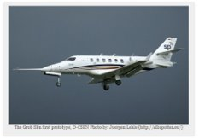
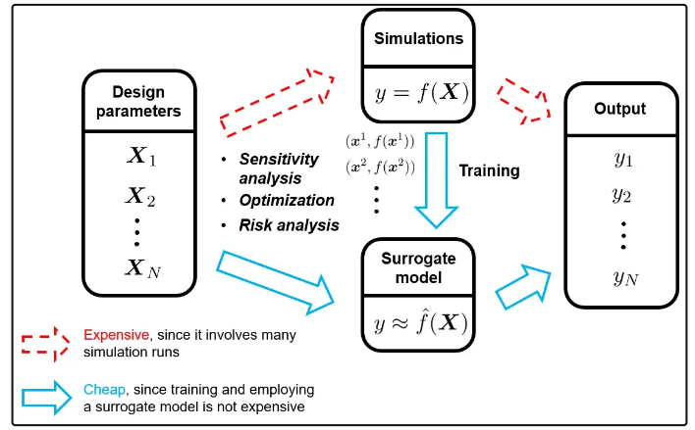
Introduction
Theory
Methodology
Result
Conclusion
Background
Aeroelastic Analysis cost is very expensive
Hard to do! Cost money too much! Takes too much time!
Surrogate Model
Straight forward to use!
Fast simulation time!
Fig1 : Flutter caused tailplane failure and crash of Grob SPn prototype
Deep Learning
Rising Star!
Proven more effective and efficient!
Proper Orthogonal Decomposition
Famous Method in CFD
Reduced Complexity!
We Got The Title of This Work!
Fig2: Surrogate Model Comparison with Simulation
Notes:
For the background, we know that In every design phase of an airplane we need an aeroelastic analysis to avoid any failure accident due to flutter or other dangerous phenoma in aeroelastic such as shown in figure 1. Unfortunately the cost of this analysis is very expensive and its also very hard to do. That is why the alternative such as surrogate model is built to overcome those problems. This surrogate model will used the high cost of simulation data as a training data as shown in figure 2. Thats why we will also need to create a surrogate model which will use as smaller training data as possible. Then, To build the surrogate model we will utilize deep learning because its proven more effective and efficient compared to other traditional method such as kriging.We also will utilize proper orthogonal decomposition to decompose our problem into smaller dimension. Thus, reducing the complexity and enable the model to learn easier.

Slide 4
Introduction
Theory
Methodology
Result
Conclusion
Purposes
Scopes
Develop Surrogate Model Using Deep Learning
The dataset is assumed to be correctly simulated.
Develop Surrogate Model Using Proper Orthogonal Decomposition Method as a Processing Method
The model is coded in Python and produces a dynamic response of the airfoil in a given Mach and Flutter Speed
The Mach and Flutter Speed data serves as an input to the model, wherein, the model is trained and tuned such that a response dynamic (CL, CD, Pitch and Plunge Motion) is obtained.
Knowing The Effective Range of Number of POD Coefficients
Notes:
From those background then the purpose of this research will be to develop a surrogate model using deep learning to predict a respons dynamics so that we can reduce the cost of doing simulation. Then the surrogate model will be built using proper orthogonal decomposition method as a processing method and we also want to investigate the effective range of number of POD coefficients. The scopes of this research are first the dataset is taken from previous project which simulated using open source software SU2 and assumed to be correctly simulated. Then the model is coded in python and the input of the model should only the mach number and flutter speed and the output wil be a response dynamics lift and drag coefficient, pitch and plunge motion.

Slide 5
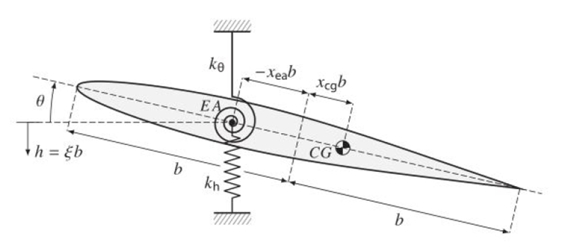
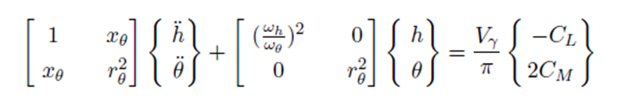
Introduction
Theory
Methodology
Result
Conclusion
Aeroelastic
Analysis
Proper Orthogonal Decomposition
Procedures of POD (Weiss,2019)
Define solution matrix
Decompose Solution Matrix Using SVD
Define the amount of POD coefficients and truncate the U vector from previous step.
Fig3: Aeroelastic Analysis Diagram
Calculate The POD Coefficients
Eq1: Aeroelastic Analysis Diagram
Map the POD Coefficient to Each Input and Predict New Label
Analyze using ISOGAI Case
Only 2 dominant structural are considered. They are Flexural and Torsional Bending
Only 2 motion is allowed. They are Pitching motion and Plunging Motion
Reverse The Prediction From POD Space into Original Data Space
Notes:
For the Theory section, First is the aeroelastic analysis. The matrix equation on the screen is the equation we want to develop the surrogate model. So the surrogate model should be capable to solve this equation. This equation is only consider 2 dominant structural bending. They are flexural and torsional bending. The motion allowed is also only a pitching and plunging motion.
Next is the Proper Orthogonal Decomposition Method. It’s a actually a procedure to extract a basis for a modal decomposition from an ensemble of signals. It is a dimensional reduction process that will change the n-dim input into a set of linear coefficients. In short, the model is expected to predict all the POD coefficients and use them to construct the original signal. The procedures are first []

Slide 6
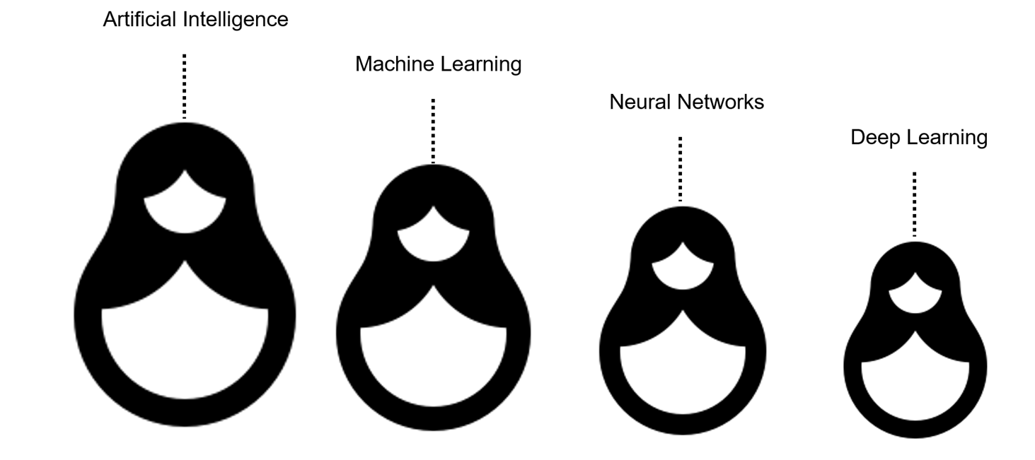
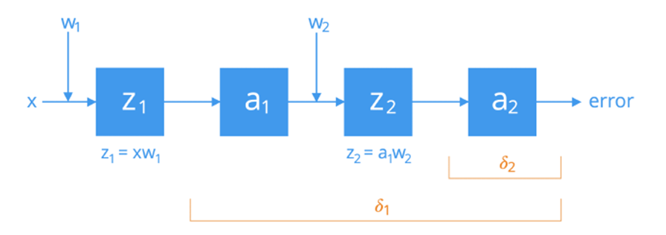
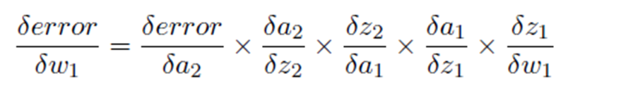
Introduction
Theory
Methodology
Result
Conclusion
Matrix Pencil
Deep Learning
Procedures of Matrix Pencil by (Jacobson et al., 2019)
Define solution matrix H
Form Hankel Matrix Y
Decompose Hankel Matrix
Create V1 and V2 Matrix
Calculate Matrix A
Calculate Eigen Values of A
Calculate the growth Factors
Training Neural Network
Backpropagation
Method!
Notes:
The next procedures is called matrix pencil. This is one of the prony series method and it will be used to test the result of the models by predicting the damping coefficients. The Prony series method is a way to calculate the increment/growth of a signal by decomposing a signal into a sum of damped sinusoids. We used matrix pencil because it can provide an automated way to select the number of Prony series terms using the results from an eigendecomposition. This Done by predicting the eigenvalues and then using them to predict the growth factor. The procedures are[].
The last theory is about deep learning. Deep learning is inspired by the biological process of the brain and it’s a part of neural network, machine learning and artificial intelligence. It’s a method to find the correlation of input and output of a data by generalize the pattern of each input to output. This is the reason this method needs so much data. Normally it consist of 3 types of layers they are input, hidden, and output layers and each layer consist of at least 1 neuron. The network is Trained by adjusting the weight to reduce its loss as the step increased. The method is called Backpropagation.

Slide 7
Introduction
Theory
Methodology
Result
Conclusion
Problem Statement
Methodology
Predict the aerodynamic properties of airfoil NACA 64A010
The properties will be predicted are Lift Coefficient, Drag Coefficient, Plunging Motion, and Pitching Motion.
The model input should only be the flow characteristic (mach) and material characteristic (flutter speed)
The flight range will be mach 0.6 until mach 0.9
Flutter speed range is vf 0.4 until vf 2.0
Acquiring Data
Processing Data
Training

Slide 8
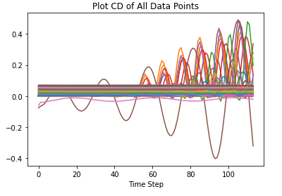
Introduction
Theory
Methodology
Result
Conclusion
Acquiring Data
Raw Dataset Properties
The smaller the amount needed to train the model will be better.
The amount of data used to train the model is 150, 100, and 50 data.
The data scale and the distribution are not very good as the max data is almost ten to hundred times bigger than the mean and its deviation.
Property | CD | CL | PLUNGE | PITCH
Count | 228 | 228 | 228 | 228
Average | 0.017 | -0.013 | 0.002 | 0.004
Std | 0.035 | 0.172 | 0.025 | 0.029
Min | -0.404 | -1.786 | -0.301 | -0.336
Max | 0.491 | 1.741 | 0.295 | 0.388
Tab2: Descriptive Statistic of Raw Data
Fig5: Data Properties of All Target Property
Notes:
The first step in methodology is to acquire the data. The dataset is the result of aeroelastic simulation of euler equation so there are many data but we will only use the 4 target properties. The raw dataset have more than 200 data but we will use as small as possible because we want to reduce the cost. The smallest data we can use to train the model is 50 data but I will also show u the result of 100 data and 150 data. The raw data is not a good data to train the model because its distribution is not good as the max data is almost ten to hundred times bigger than the mean and the deviation. For more clear picture we can see this drag coefficients. This shows us how bad the distribution data is. This also the reason why we need to rescale it before use it to train the model.

Slide 9
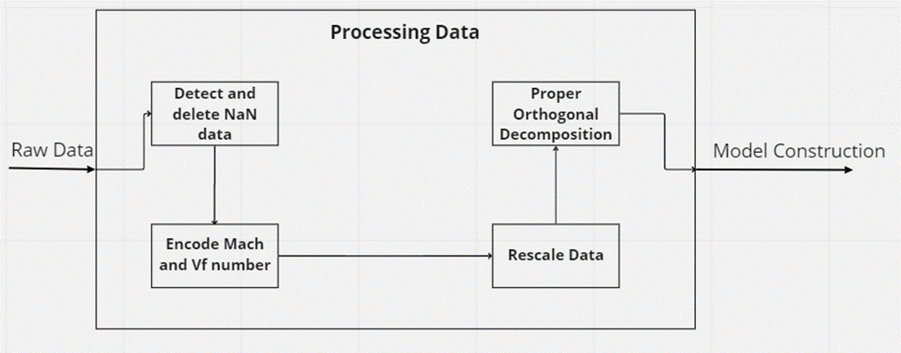
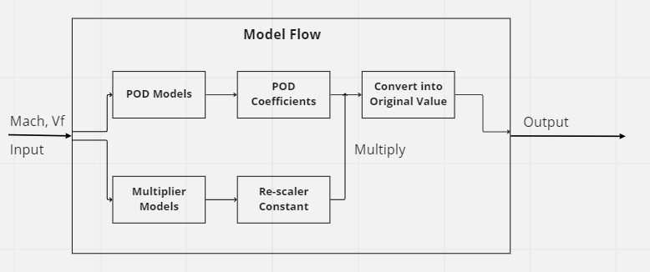
Introduction
Theory
Methodology
Result
Conclusion
Processing Data
Flow Chart
Fig6: Flow Chart of Methodology
Fig7: Model Flow
Notes:
Next is the flowchart of processing data and model flow. For processing data the first step is to detect and delete NaN data this will done by utilizing the numpy function. then encode the mach number and vf number from the file name to form the input data this will done by using the regular expression module, then the data will be rescaled to form the labels. Last it will be used to form the solution matrix in POD process.
For model flow there will be two input then it will be used for both the models. The POD models output will be POD coefficients and multiplier models output will be the rescaler constant. Then the output of pod model will be multiplied by the rescaler and convert it back to original space.

Slide 10
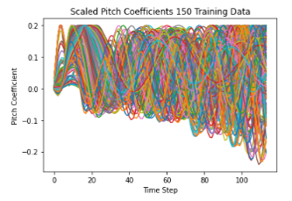
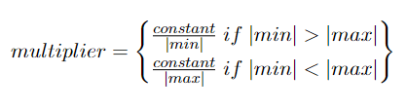
Introduction
Theory
Methodology
Result
Conclusion
Processing Data
Rescale The Data
Train The Models
Multiplier/Scaler Models
POD Models
The input is mach number and vf value
The output is the scaler/multiplier constant
Trained for 1000 epochs
Used the same construction as POD Models for simplicity
The input is mach number and vf value
The output is the POD coefficients
Trained for 1000 epochs
Tuned with keras_tuner
Tuning Parameter
Tuned using random search
Maximum Layer = 6, step = 1.
Maximum Neuron = 600, step = 100.
Tuning Epochs = 100, step = 1.
Loss Function = MAE
Activation choices = linear or rectified linear (ReLu)
Other properties will be left default
Fig8: Data of Training Targer of POD Models
Eq6: The Multiplier Formulation
Notes:
The example of the result of the rescale step is shown in this figure, from this figure we can see that the data have become uniform. This will make the POD models only care about the shape of each figure and the Multiplier models will take care of the scale. The function use to find the multiplier constant is shown in eq 6. From this equation the constant is the standard distribution of the data for each property then it will be divided by the absolute of maximum or minimum data each data point has. We will use the minimum if the absolute minimum value is larger than the absolute of maximum value and vice verca.
Next is the model properties. This is shown here [bacain]

Slide 11
Introduction
Theory
Methodology
Result
Conclusion
Model Construction
Training
Tab4: Model Construction
Layers | Activation | Input Dimension | Output Dimension
Input | ReLu | None,2 | None,200
Dense1 | ReLu | None,200 | None,600
Dense2 | ReLu | None,600 | None,300
Dense3 | ReLu | None,300 | None,500
Output | Linear | None,500 | None,K
Validation Space
Tab5: Validation Space
CD (Mach, Vf) | CL(Mach, Vf) | Pitch(Mach, Vf) | Plunge(Mach, Vf)
0.68, 0.6 | 0.657, 1.23 | 0.64, 0.7 | 0.677, 1.92
0.7, 1.4 | 0.75, 0.4 | 0.775, 1.6 | 0.7625, 1.0
0.825, 2.0 | 0.88, 2.0 | 0.884, 0.747 | 0.843, 0.96
Test Space
Tab6: Test Space
CD(Mach, Vf) | CL(Mach, Vf) | Pitch(Mach, Vf) | Plunge(Mach, Vf)
0.62, 0.4 | 0.6,2.0 | 0.6, 2.0 | 0.675, 1.7
0.775, 0.5 | 0.7, 1.7 | 0.7, 0.7 | 0.7, 1.3
0.826, 0.896 | 0.825, 0.5 | 0.822, 1.76 | 0.826, 0.896

Slide 12
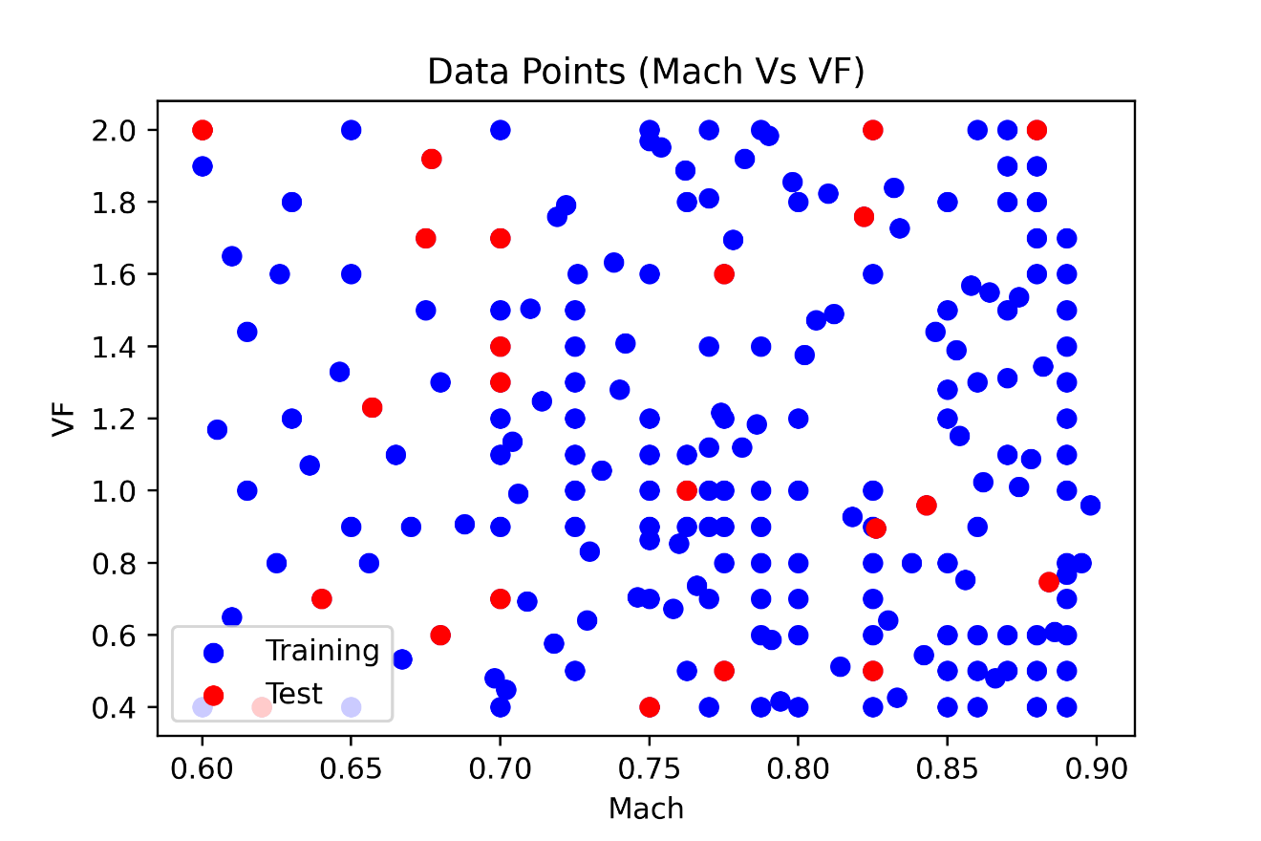
Introduction
Theory
Methodology
Result
Conclusion
Result
Processing Data and Training Result
Encoder Result
Fig9: Data Points
Data Points shown above is the result from encoder step.
Data Points will be used as input for all the models used in this project.

Slide 13
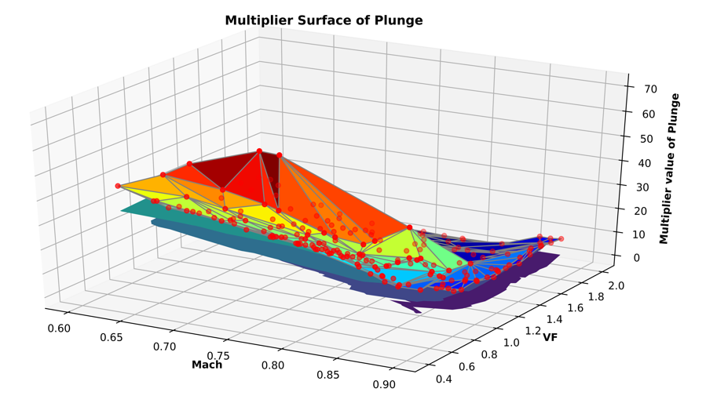
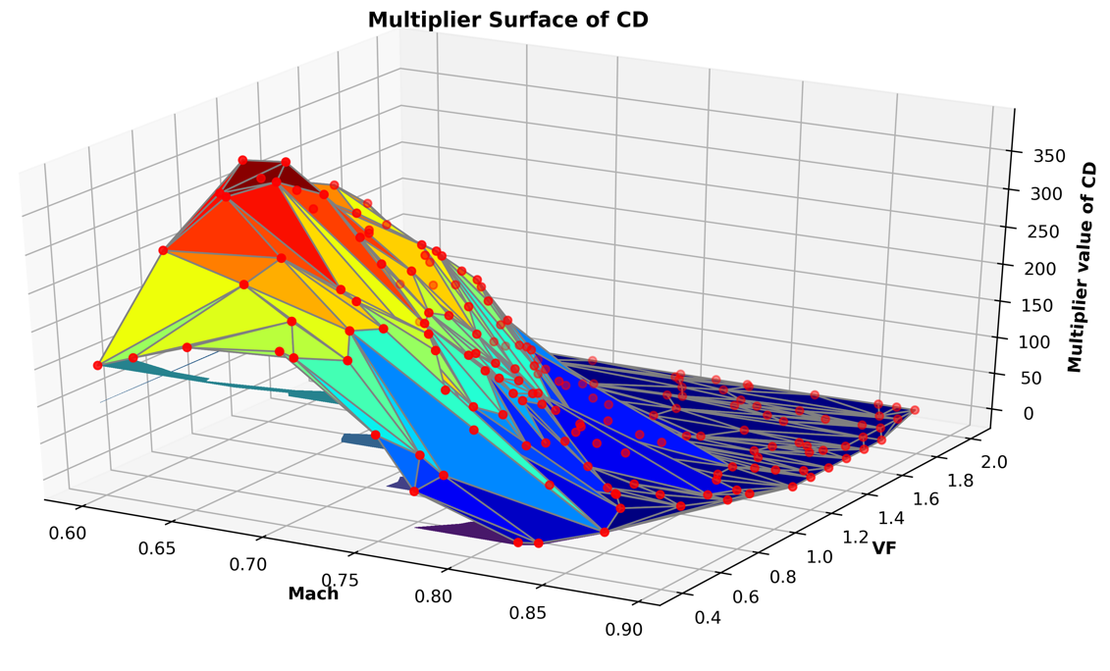
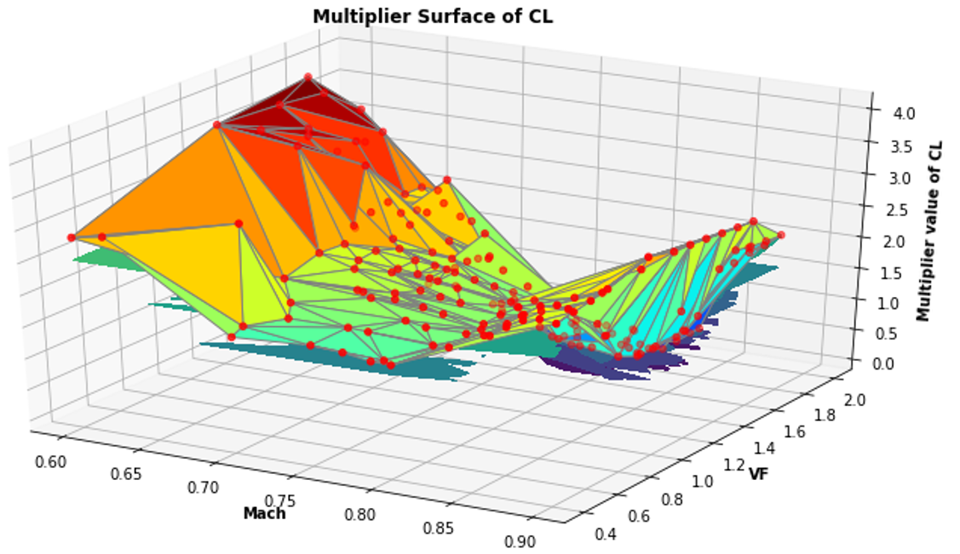
Introduction
Theory
Methodology
Result
Conclusion
Processing Data and Training Result
Scaler Result (Models Label)
The scale varied between each target property.
The largest differences in scale for each category is the CD
This figures show the importance of this scaler model
Fig10: Models Label of Scaler Models
Notes:
This figures is the multiplier constant extracted from rescaler step. This figure will be the label for the multiplier models. From this figure we can see that the scale of each target properties are very varied. Here it goes up to 300 for CD, less than a hundred for plunge and pitch, and it less than ten for CL. Not only that for each datapoints in the same target property we the scaler also very varied. This is the reason why we need the scaler model.

Slide 14
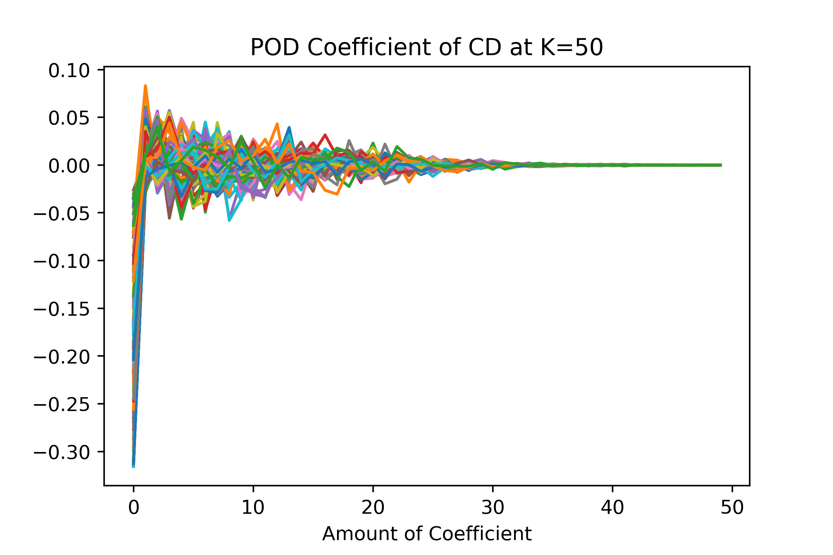
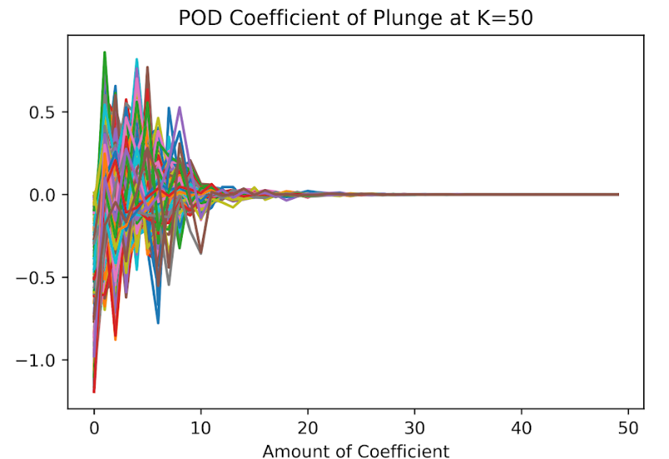
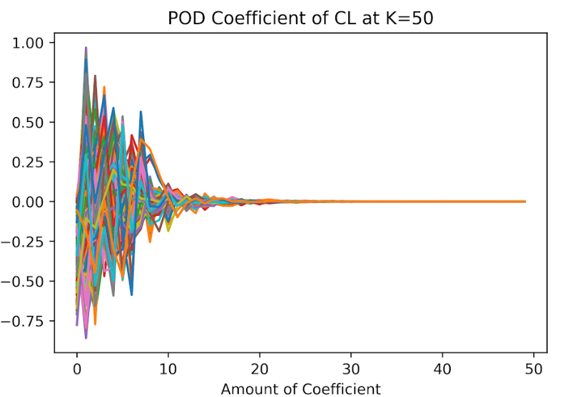
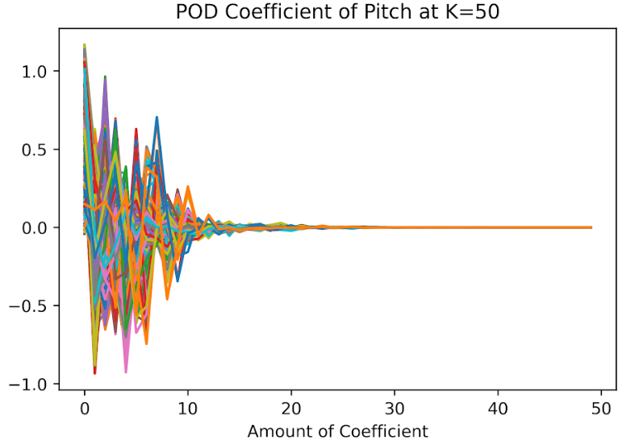
Introduction
Theory
Methodology
Result
Conclusion
Processing Data and Training Result
POD Coefficients (Models Label)
K=35 is enough to represent all target properties
Not all coefficient needed to represent the original curve
Fig11: Models Label of POD Models
Notes:
For this figures, they are the POD coefficients. Our POD models are expected to predict this coefficient. From this figures, we can see that at the end of the curve its only a straight horizontal line at y=0. What this means is we don’t need all the coefficient to represent the original curve. From these figures, we can also see that the amount of POD coefficients or K value needed to represent the curve is 35 at least.

Slide 15
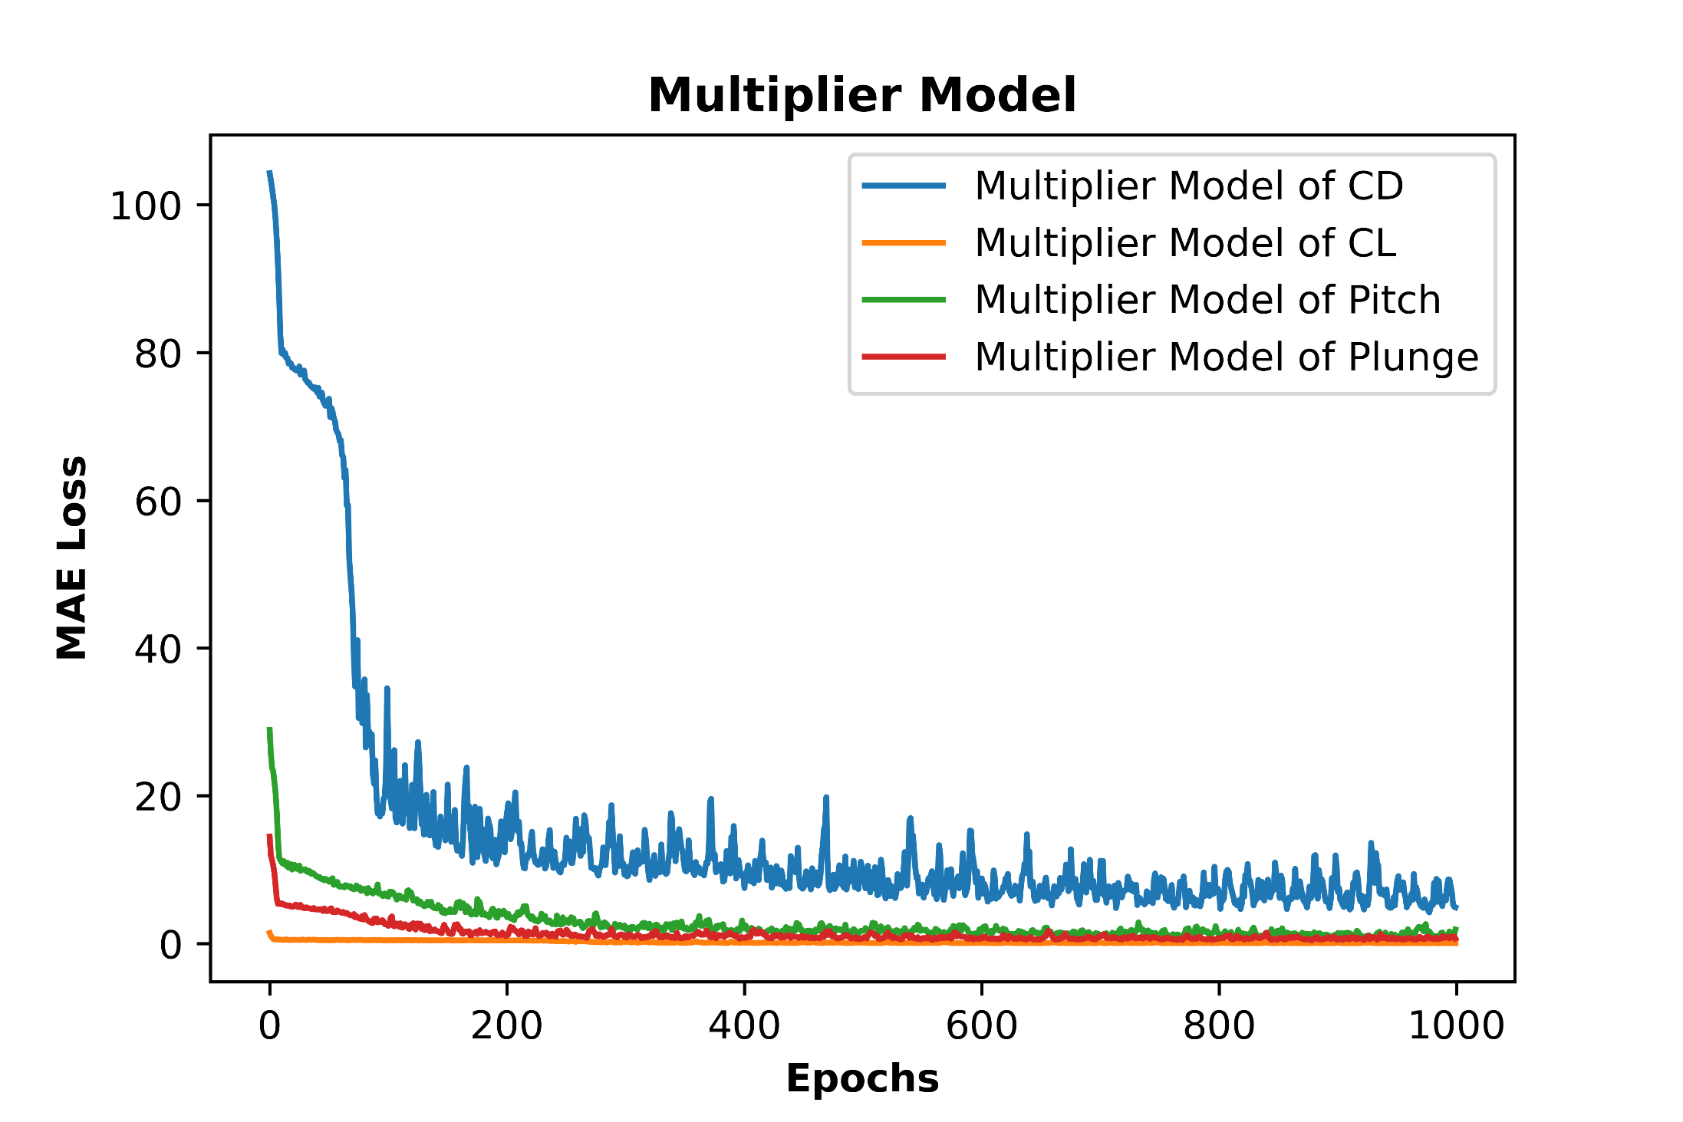
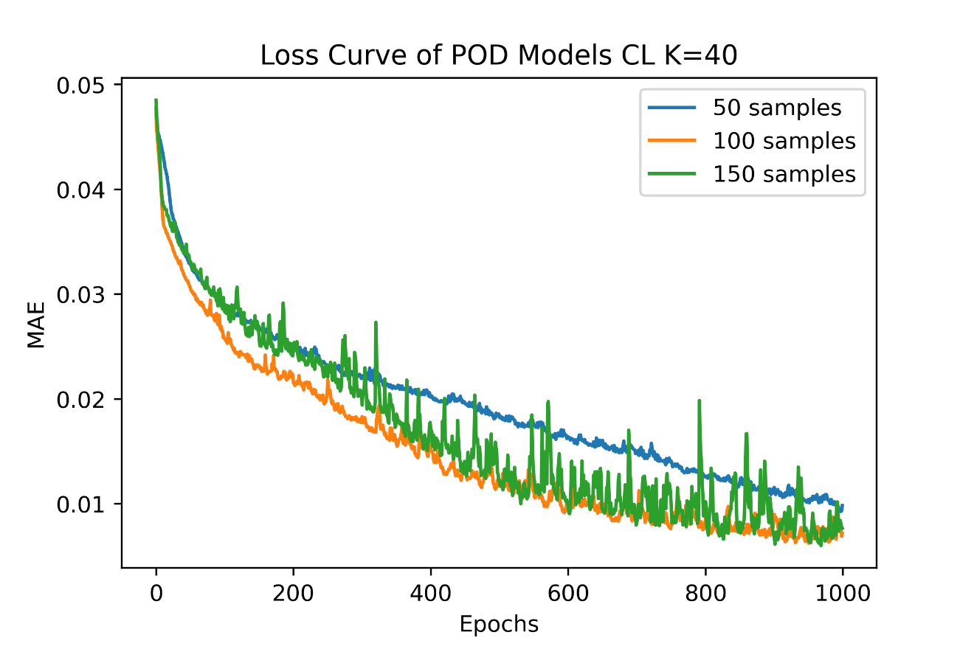
Introduction
Theory
Methodology
Result
Conclusion
Processing Data and Training Result
Training Results
Fig12: Models Loss Curve
The loss has converged.
The final MAE of Multiplier [CD, CL, Pitch, Plunge] are [4.89,0.03,1.87,0.67]
Notes:
For this slide, they are the loss curve obtained after the training step. Because we have 2 models then here we can see 2 different loss curve one from multiplier model and the other from POD models. From these figures we can see that at the end of training loop the losses value have converged. The value of loss at multiplier model is shown here []. And for the POD models I will show u more detail in next slide.

Slide 16
Introduction
Theory
Methodology
Result
Conclusion
Processing Data and Training Result
Training Results (POD Models)
Models Label | 50 Samples | 100 Samples | 150 Samples
CD | 0.0124 | 0.0095 | 0.0089
CL | 0.0839 | 0.0551 | 0.054
Pitch | 0.0839 | 0.0615 | 0.0437
Plunge | 0.1001 | 0.0704 | 0.0467
Tab7: Training Results of POD Models
The lowest value of MAE is at drag coefficient whereas the largest is at plunge.
The bigger the size of the training data the lower the MAE
Notes:
this table here summarize the loss of POD models at the end of the training loop. From here we can wee that the lowest value of MAE loss is at drag coeff whereas the largest is at plunge. The next thing we can get from the table is the bigger the training size the lower the loss we get.

Slide 17
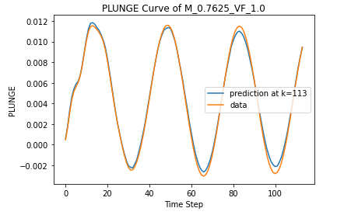
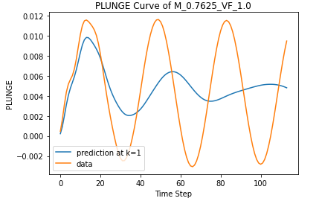
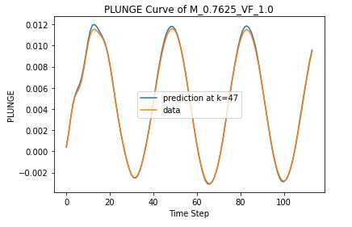
Introduction
Theory
Methodology
Result
Conclusion
Validation
Reduction in performance
Fig13: Pitch and Plunge Validation Results
Reduction in Performance
Small amount of K will not be able to represent the curve
Too much amount of K will slightly decrease the performance
Notes:
Next is the result from validation step. This step purpose is to know the behavior of the prediction as we change the K value. And from the results, we can see that the small amount of K will make the prediction cant follow the original curve. Here we can see that at K around 40 we can get the good prediction curve. Also if we use very large number of K here is at the maximum value of K we get that the performance decrease although only slightly.

Slide 18
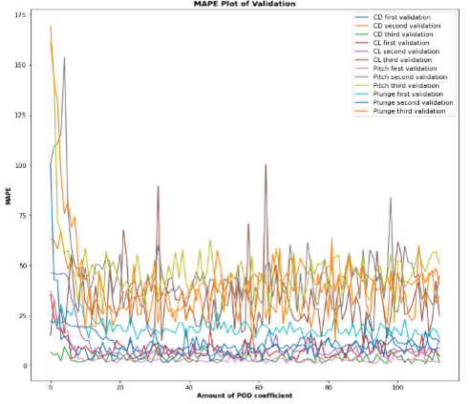
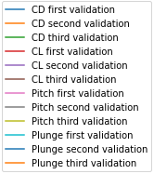
Introduction
Theory
Methodology
Result
Conclusion
Validation
MAPE Plot of Validation
Validation Conclusion
The bigger amount of K makes the performance better.
Too many POD coefficients also decrease the performance
Minimum amount to represent all the properties is 35.
From all those information, then the recommended K value is at least 35.
MAPE
Amount of POD Coefficients
Fig14: MAPE Plot of Validation
Notes:
Then by mapping the MAPE plot for all the validation datapoints we can take a conclusions that []

Slide 19
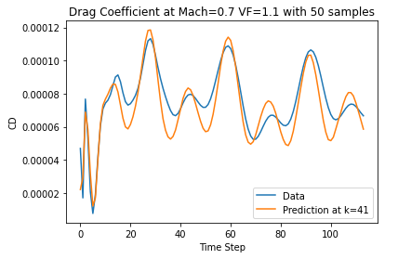
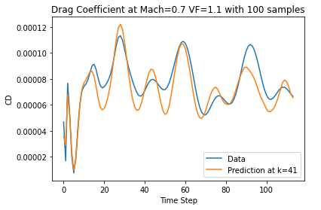
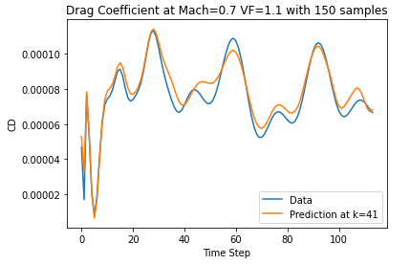
Introduction
Theory
Methodology
Result
Conclusion
Test
Prediction Test (CD)
Fig15: Prediction Test on CD
The qualitative way to measure a good result is by seeing how well it follows the original curve.
The quantitative way is by computing its MAPE. MAPE more than 50% is the threshold used in this project.
Notes:
Next is test step, This results shows that the model already able to make a good predictions. Here we define a prediction is a good by 2 method. First is by qualitative way. Its by seeing how well the prediction curve follow the original curve. Next is by quantitave way. Its done by computing its MAPE and we use the threshold 50%. Also From these figures we can see that the bigger the training size the better.

Slide 20
Introduction
Theory
Methodology
Result
Conclusion
Test
Prediction Test (CD)
Test CD | Metrics | 50 Samples | 100 Samples | 150 Samples
1 (M=0.6) | MAE | 0.0155 | 0.0166 | 0.0165
 | MAPE (%) | 29.79 | 22.49 | 9.36
2 (M=0.7) | MAE | 0.0186 | 0.0185 | 0.0204
 | MAPE (%) | 11.92 | 10.85 | 6.55
3(M=0.8) | MAE | 0.0168 | 0.0183 | 0.0185
 | MAPE (%) | 36.9 | 29.4 | 18.0
Tab8: Test Results of Prediction Test on CD
The MAPE of this test phase is closer to 50%
The further decreasing training size will make several test phase MAPE goes to >50%
Notes:
This table will summarize all the result from test datapoints. From here its clear that the bigger the training size the better and at samples equal to 50 we have the MAPE reach to 37% and this is the reason there is no lower samples than 50 because if we decrease the training size again it will make the MAPE goes outside of 50%

Slide 21
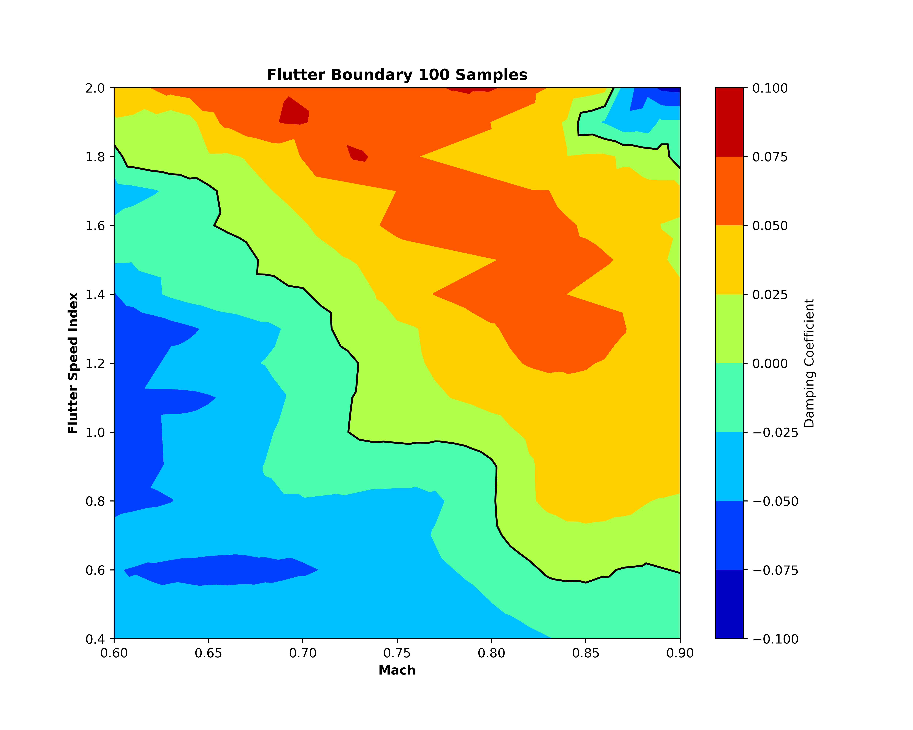
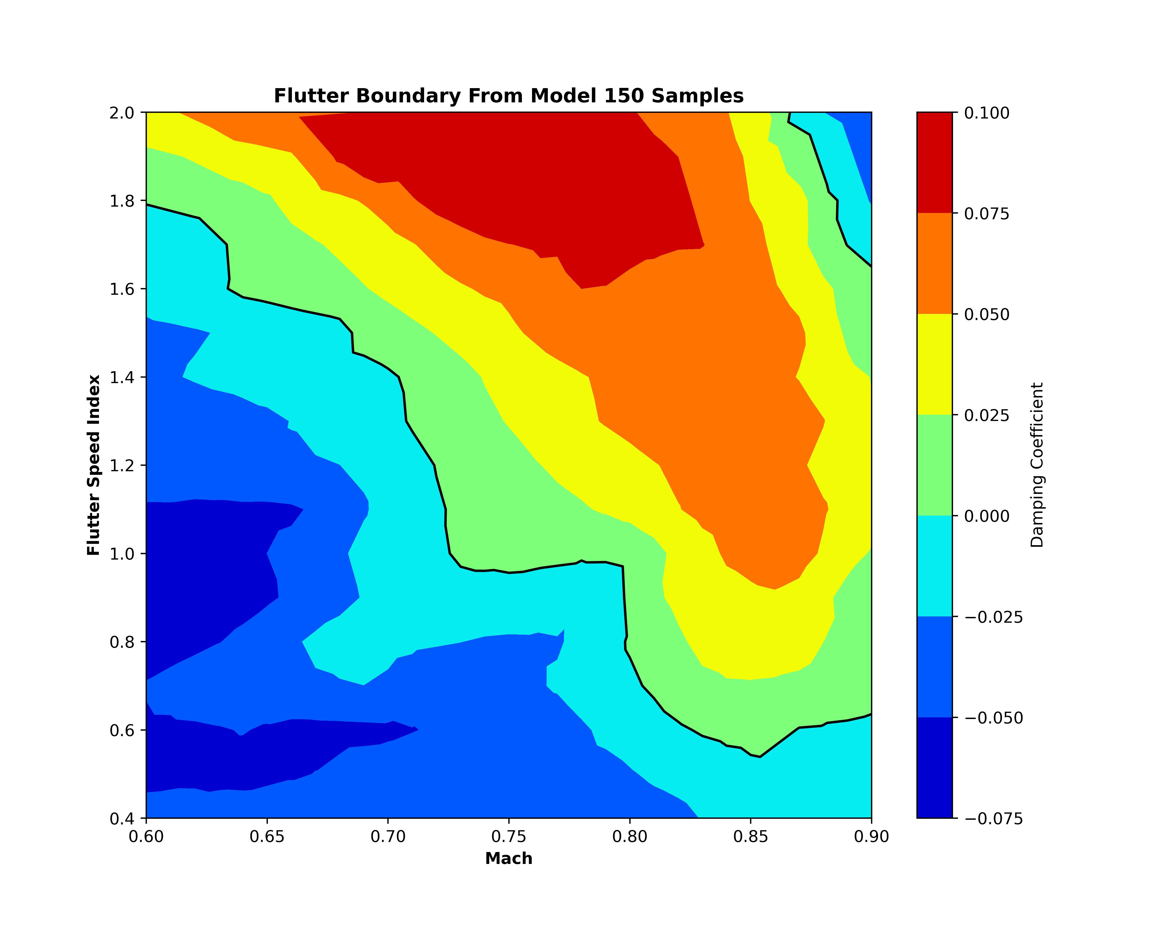
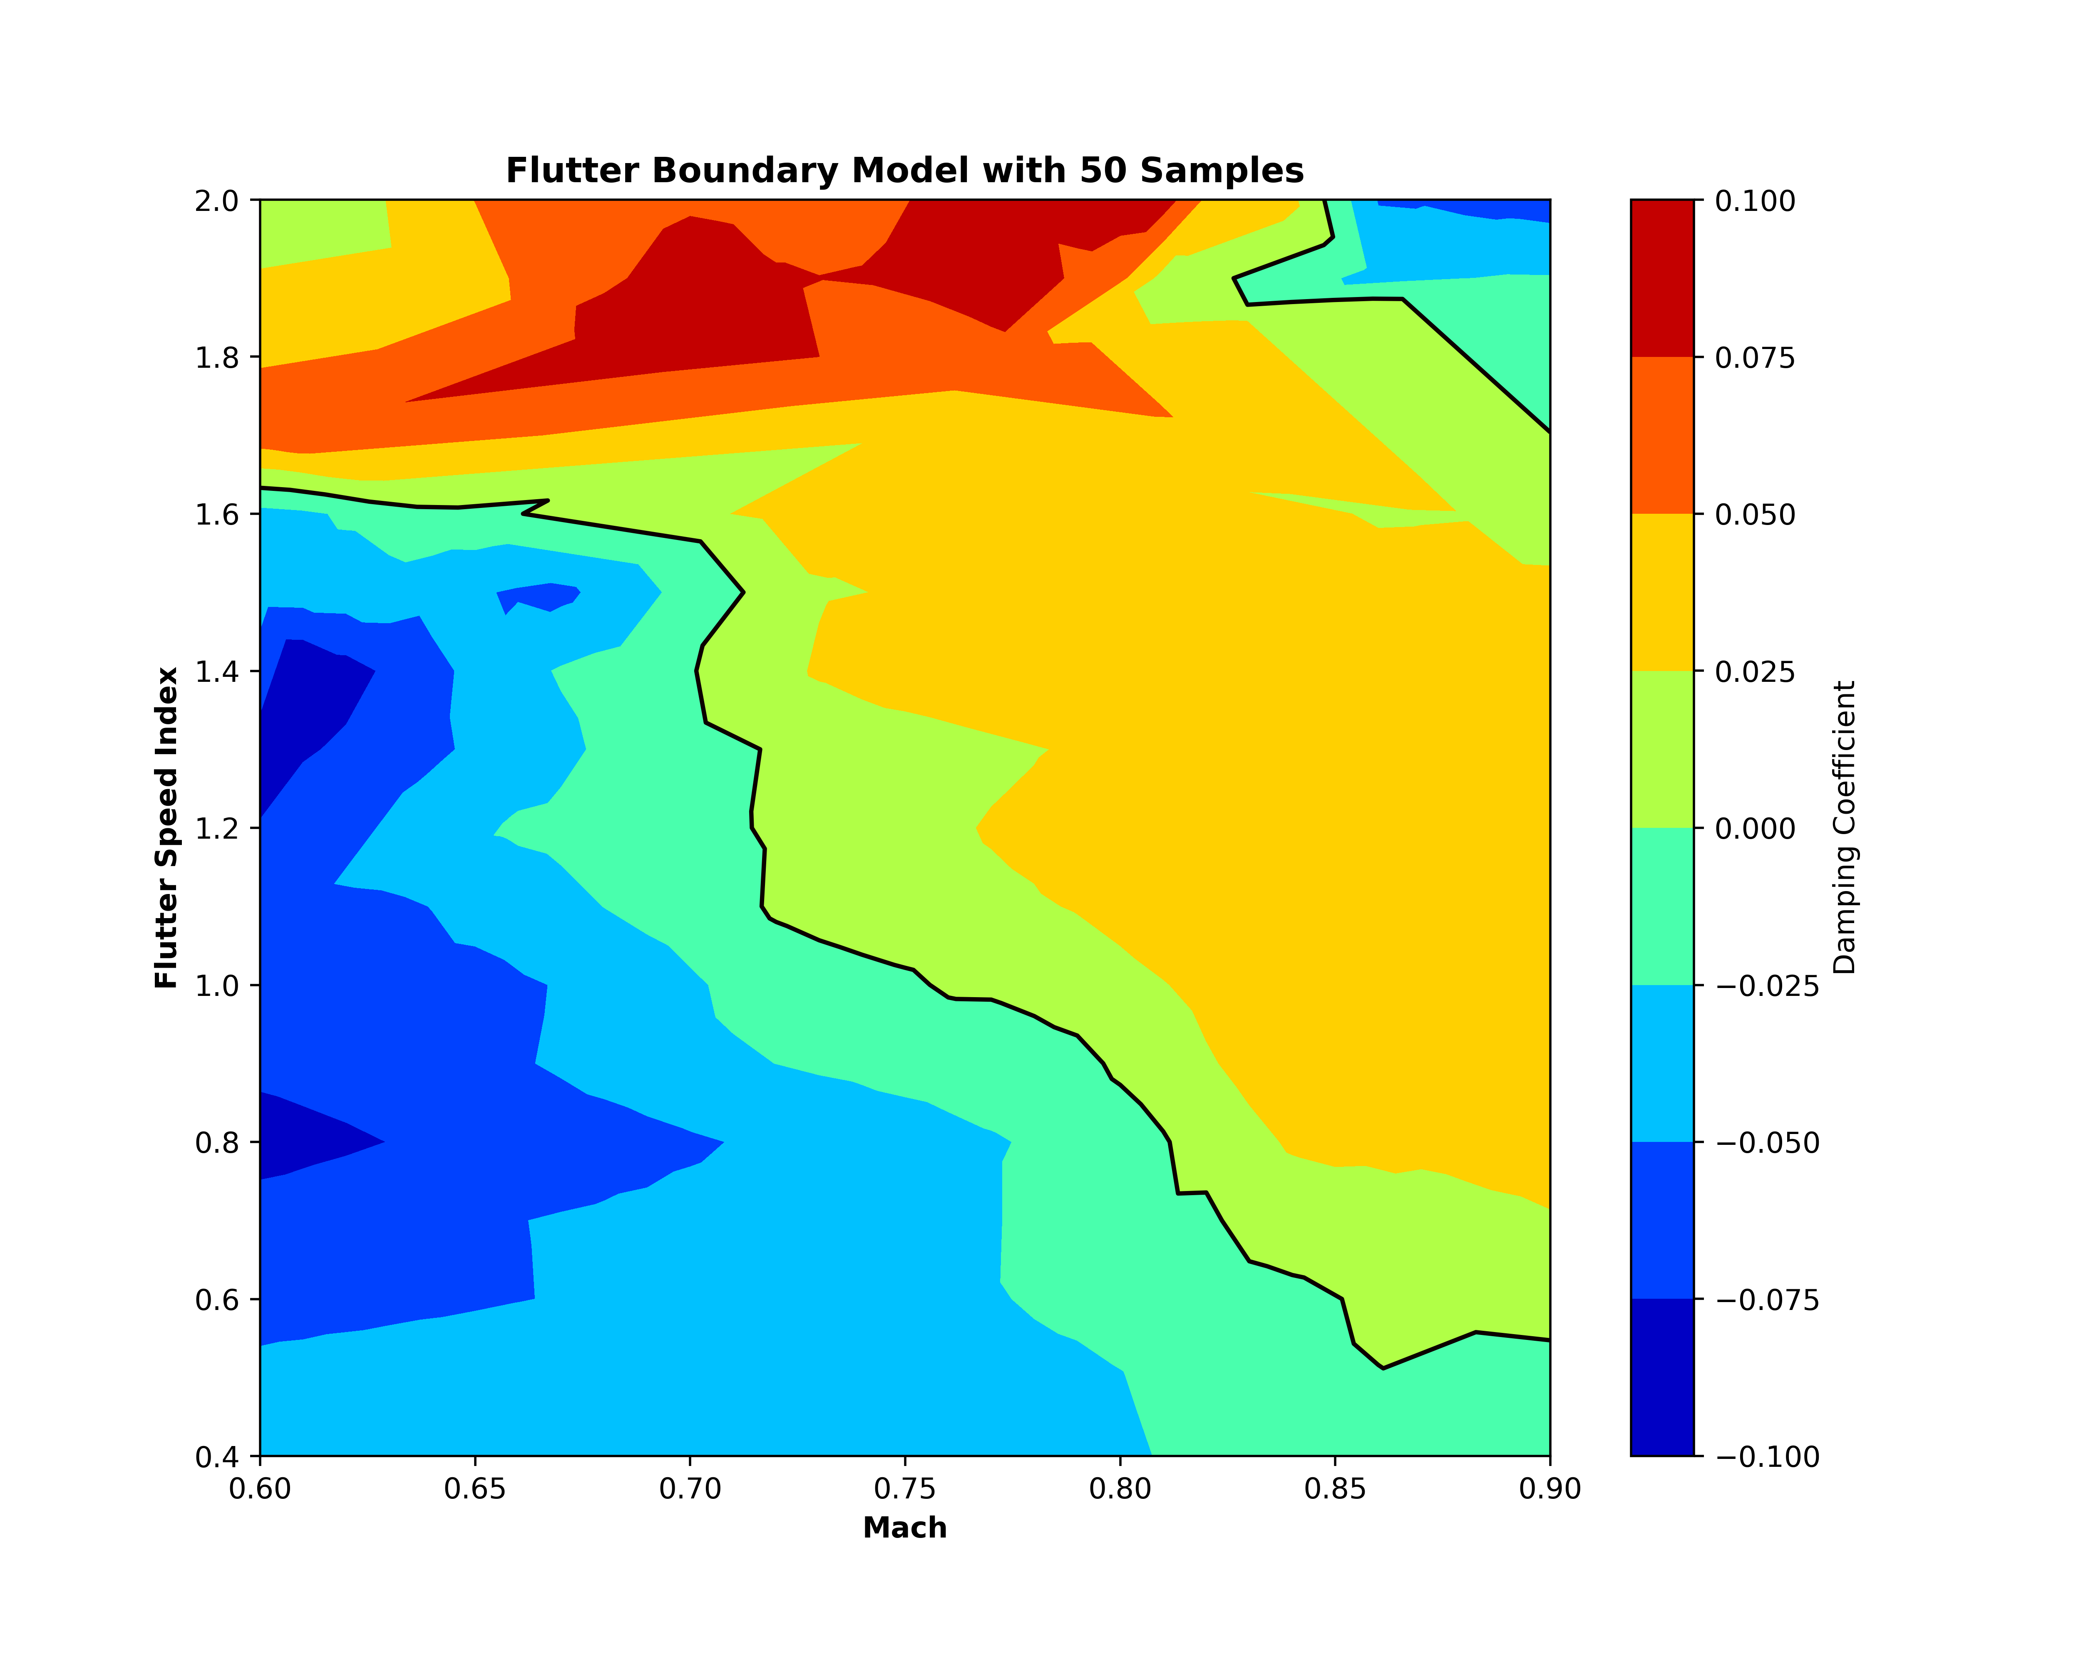
Introduction
Theory
Methodology
Result
Conclusion
Test
Damping Coefficient Test
Fig17: Damping Coefficient Test
Improvement at highest damping coeff
Notes:
Here we have the result from matrix pencil method, This is the flutter boundary contour plot. From here we can see that the larger the training size the model will be more accurate at predicting higher value of damping coefficients.

Slide 22
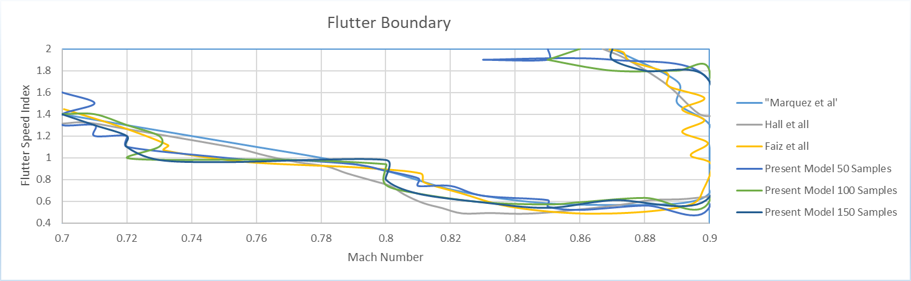
Introduction
Theory
Methodology
Result
Conclusion
Test
Damping Coeff Test
Fig18: Flutter Boundary Results Compared to Previous Work
From this figure, our models is proven capable to predict the flutter boundary.
The flutter boundary from model 150 samples is very similar to Hall et,al
The most wider deviation is at mach 0.8 to 0.9 or at the top right figure.
Notes:
For more we can compare the flutter boundary from our model with the other previous result done by marquez, hall, and faiz. From here we can see that the model is proven capable to generate flutter boundary similar with the previous accepted work. Then we can see that the model at 150 samples is very similar with the result from Hall et al, and the most wider deviation is at mach 0.8 to 0.9 here at the top right figure.

Slide 23
Introduction
Theory
Methodology
Result
Conclusion
Test
Running Performance
CPU Time Each Prediction
Model | Preparing Data (ms) | Training Time (ms) | Prediction Time (ms) | Total (ms) | Total Time(s)
Multiplier | 636 | 40800 | 85.4 | 41521.4 | 41.52
POD(150 samples) | 1150 | 43000 | 87.9 | 44237.9 | 85.76
POD(100 samples) | 1050 | 40000 | 88.9 | 41138.9 | 82.66
POD(50 samples) | 809 | 21300 | 89.9 | 22198.9 | 63.72
110 times faster for 150 samples and 150 times faster for 50 samples than Simulation Time.
4 times lower in training size than previous work (Faiz, 2020)
Tab10: Running Performance (Cost)
Notes:
Last test is to see the running performance of our models. Here each prediction time is calculated by the sum of total time needed to run the multiplier model and the POD models. From here the more bigger the dataset size the longer time needed to run the prediction. Compare to simulation times we have that the models speed is 110 times faster for 150 samples and 150 times faster than simulation times for 50 samples. Then we also have 4 times lower in training size if we use 50 samples.

Slide 24
Introduction
Theory
Methodology
Result
Conclusion
Conclusion
A deep learning model is created using proper orthogonal decomposition method as a processing method to predict the aeroelastic properties with the prediction performance of MAE value lower than 0.02 and MAPE value lower than 50. The effective range of the number of POD coefficients falls in K greater than 35.
The bigger the training samples the better the prediction performance but the model can perform well with 50 samples.
The model can run 110 times faster for 150 samples and 150 times faster for 50 samples than Simulation time.
Future Work
Improvement Options can be made in
Change the dataset to a more accurate simulation method (RANS) or maybe use experiment data
Chose another type of processing data
Chose another type or model of machine learning

Slide 25
References
ASN News Report: flutter caused tailplane failure and crash of Grob SPn prototype - ASN News (aviation-safety.net)
An introduction to Surrogate modeling, Part I: fundamentals | by Shuai Guo | Towards Data Science
Izzaturrahman, Muhammad Faiz (2020). On a Support Vector Machine Approach To Surrogate Modelling: Predicting The Aeroelastic Flutter Boundary Within The Tran- sonic Mach Regime. Indonesia
Jacobson, Kevin E et al. (2019). “Evaluation of time-domain damping identification methods for flutter-constrained optimization”. In: Journal of Fluids and Structures 87, pp. 174–188
Hall, Kenneth C, Jeffrey P Thomas, and Earl H Dowell (2000). “Proper orthogonal de- composition technique for transonic unsteady aerodynamic flows”. In: AIAA journal 38.10, pp. 1853–1862.
Weiss, Julien (June 2019). “A Tutorial on the Proper Orthogonal Decomposition”. In: doi: 10.2514/6.2019-3333
Marques, Alexandre N et al. (2020). “Multifidelity Method for Locating Aeroelastic Flutter Boundaries”. In: AIAA Journal 58.4, pp. 1772–1784.
Sargent DJ. Comparison of artificial neural networks with other statistical approaches: results from medical data sets. Cancer. 2001 Apr 15;91(8 Suppl):1636-42. doi: 10.1002/1097-0142(20010415)91:8+<1636::aid-cncr1176>3.0.co;2-d. PMID: 11309761.

Slide 26
Thank You!
Terima Kasih!
Notes:
That’s all from me, thank you for listening and I hope I could get much feedback from all of you! Whether about my content or my performance!

Slide 27
Appendix: Simulation Time From Faiz
Simulation Point (M, Vf) | Computational Cost (CPU-s)
(0.7, 0.4) | 3248
(0.9, 0.4) | 4482
(0.88, 1.7) | 9198
(0.7, 2.0) | 9317
(0.7875, 2.0) | 9911

Slide 28
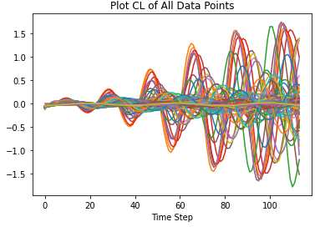
Appendix: Raw Dataset

Slide 29
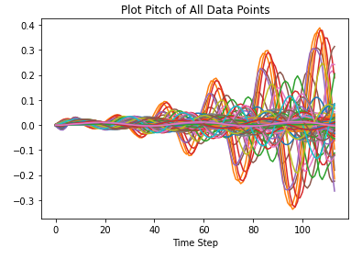
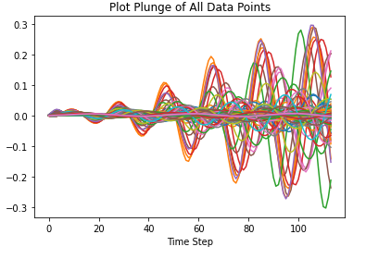
Appendix: Raw Dataset

Slide 30
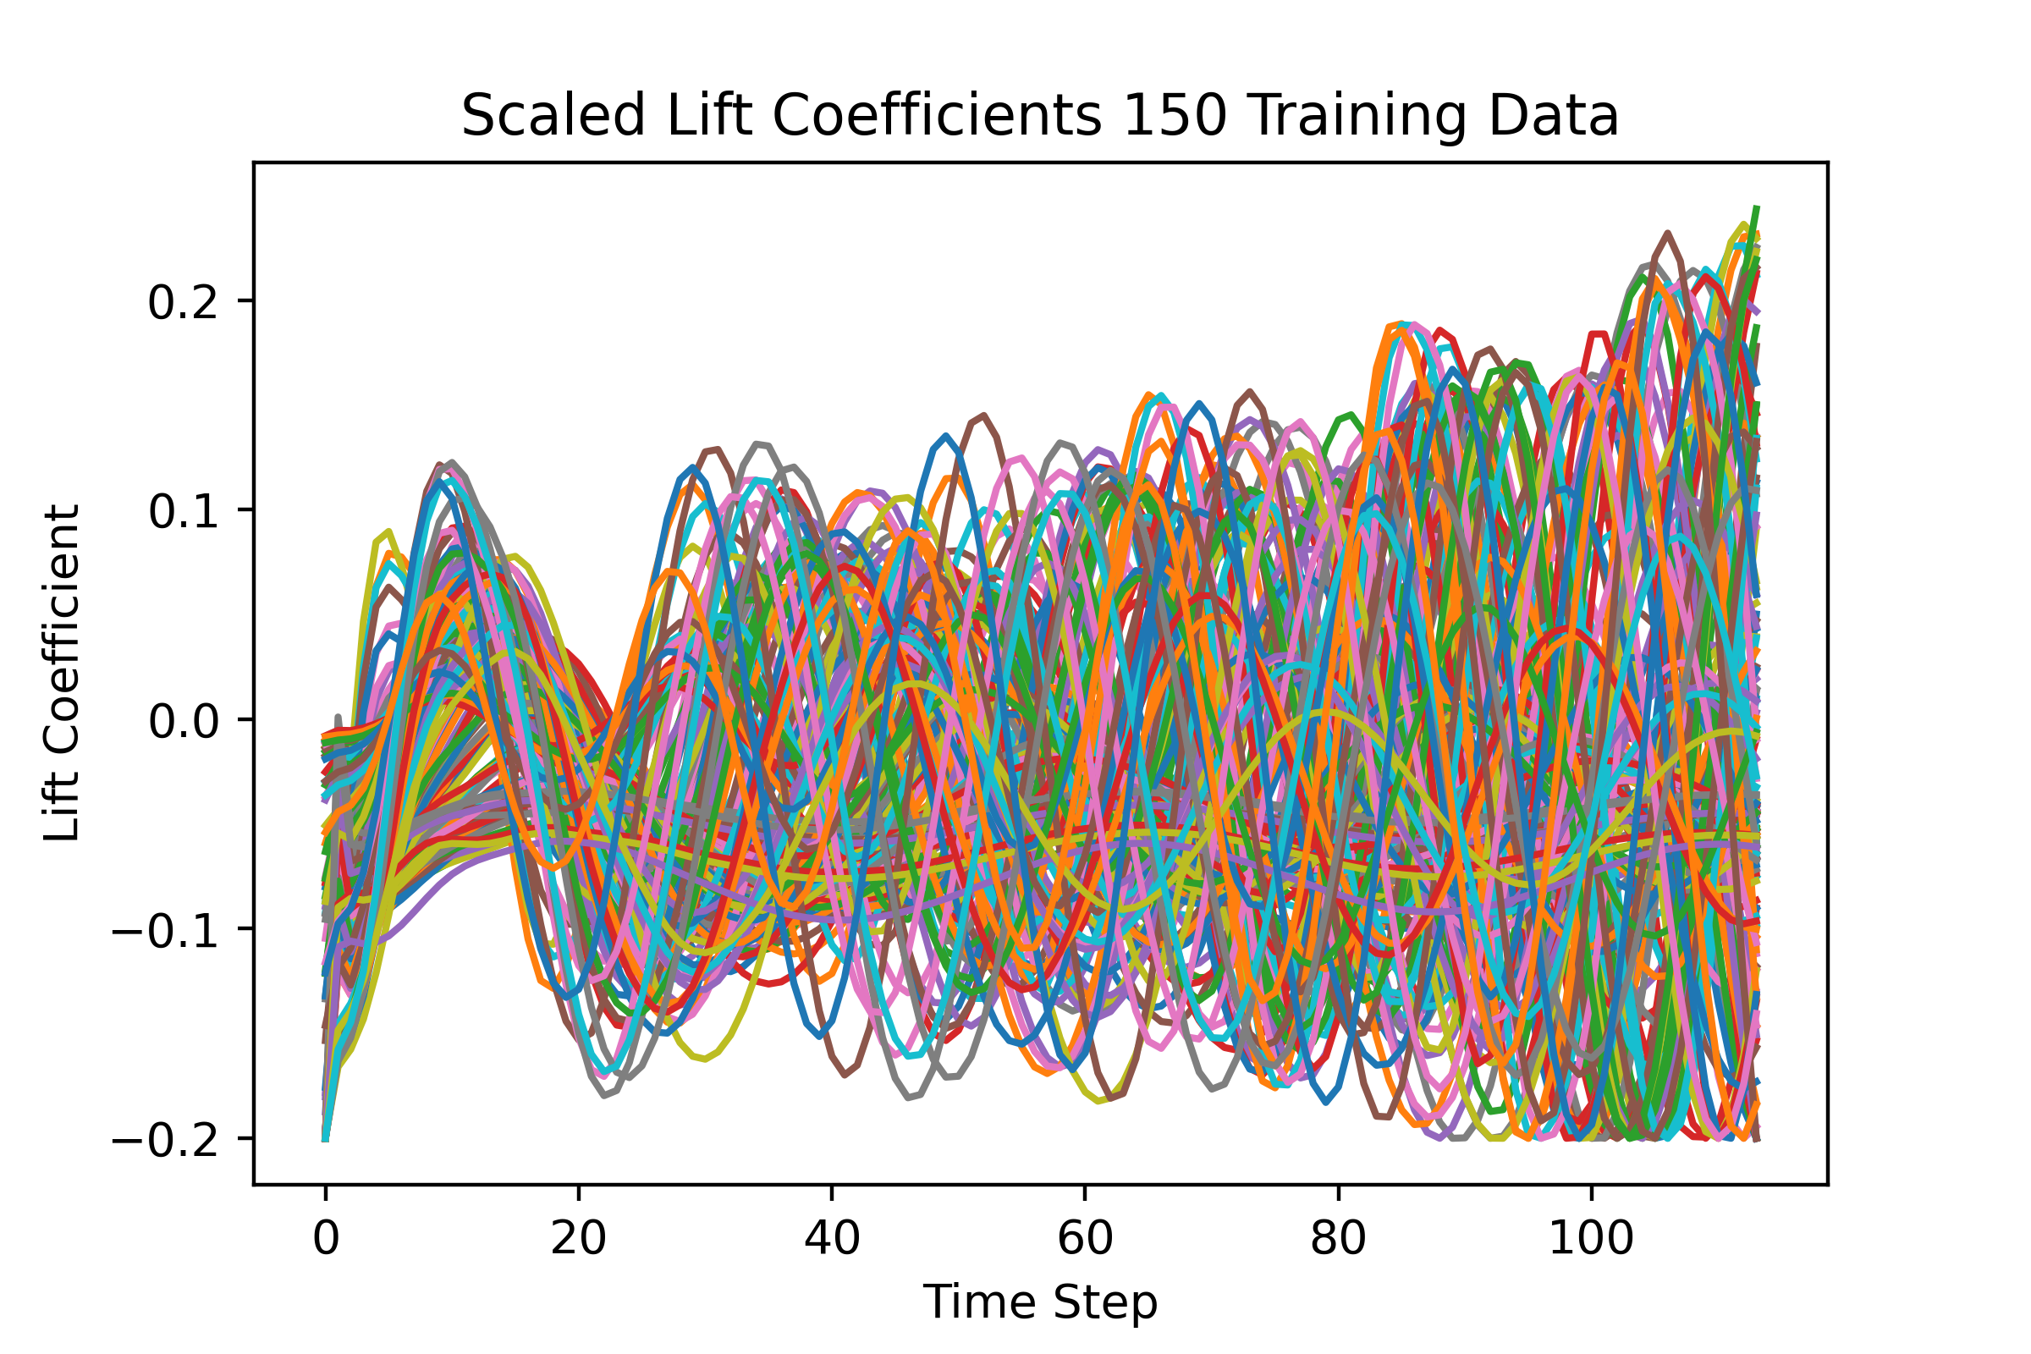
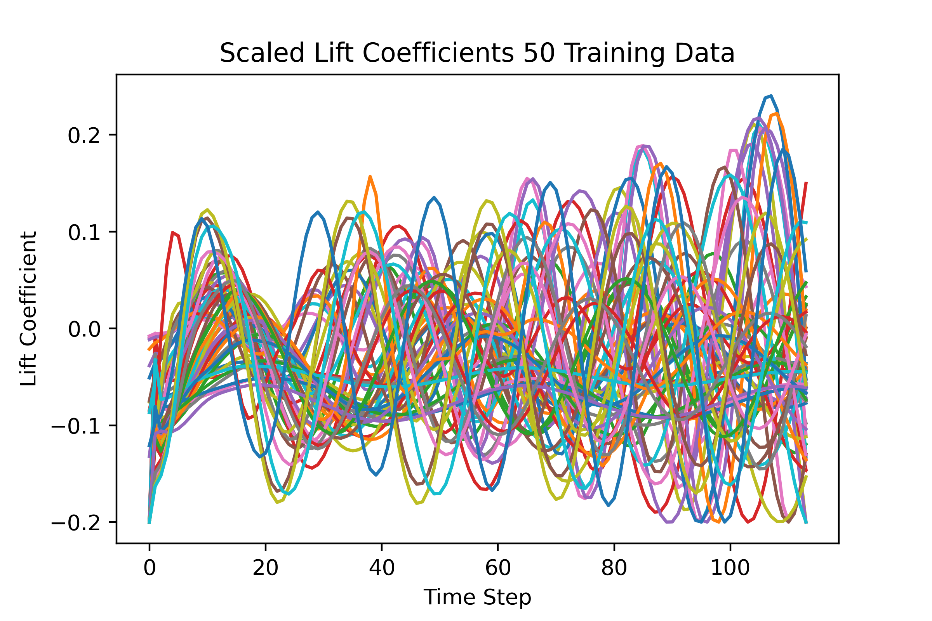
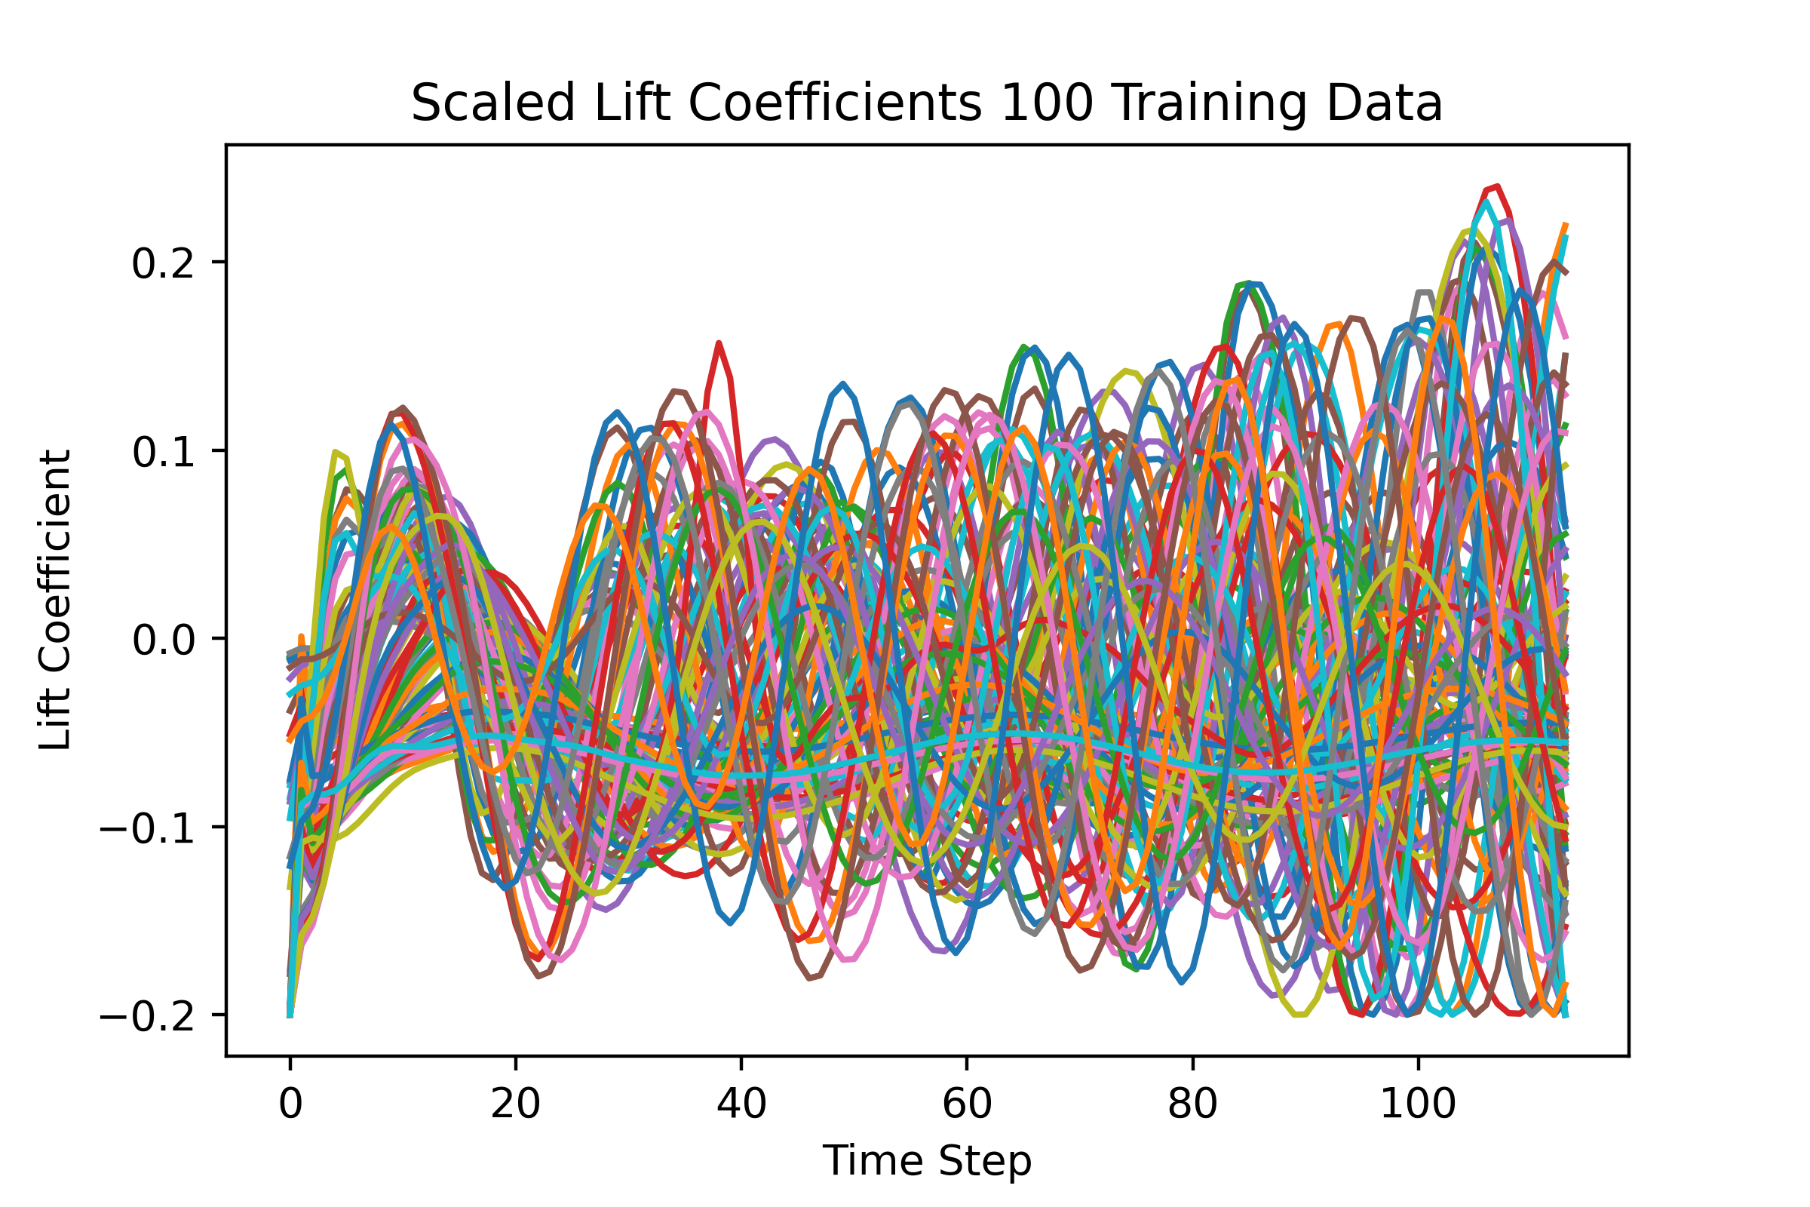
Appendix: CL Training Dataset

Slide 31
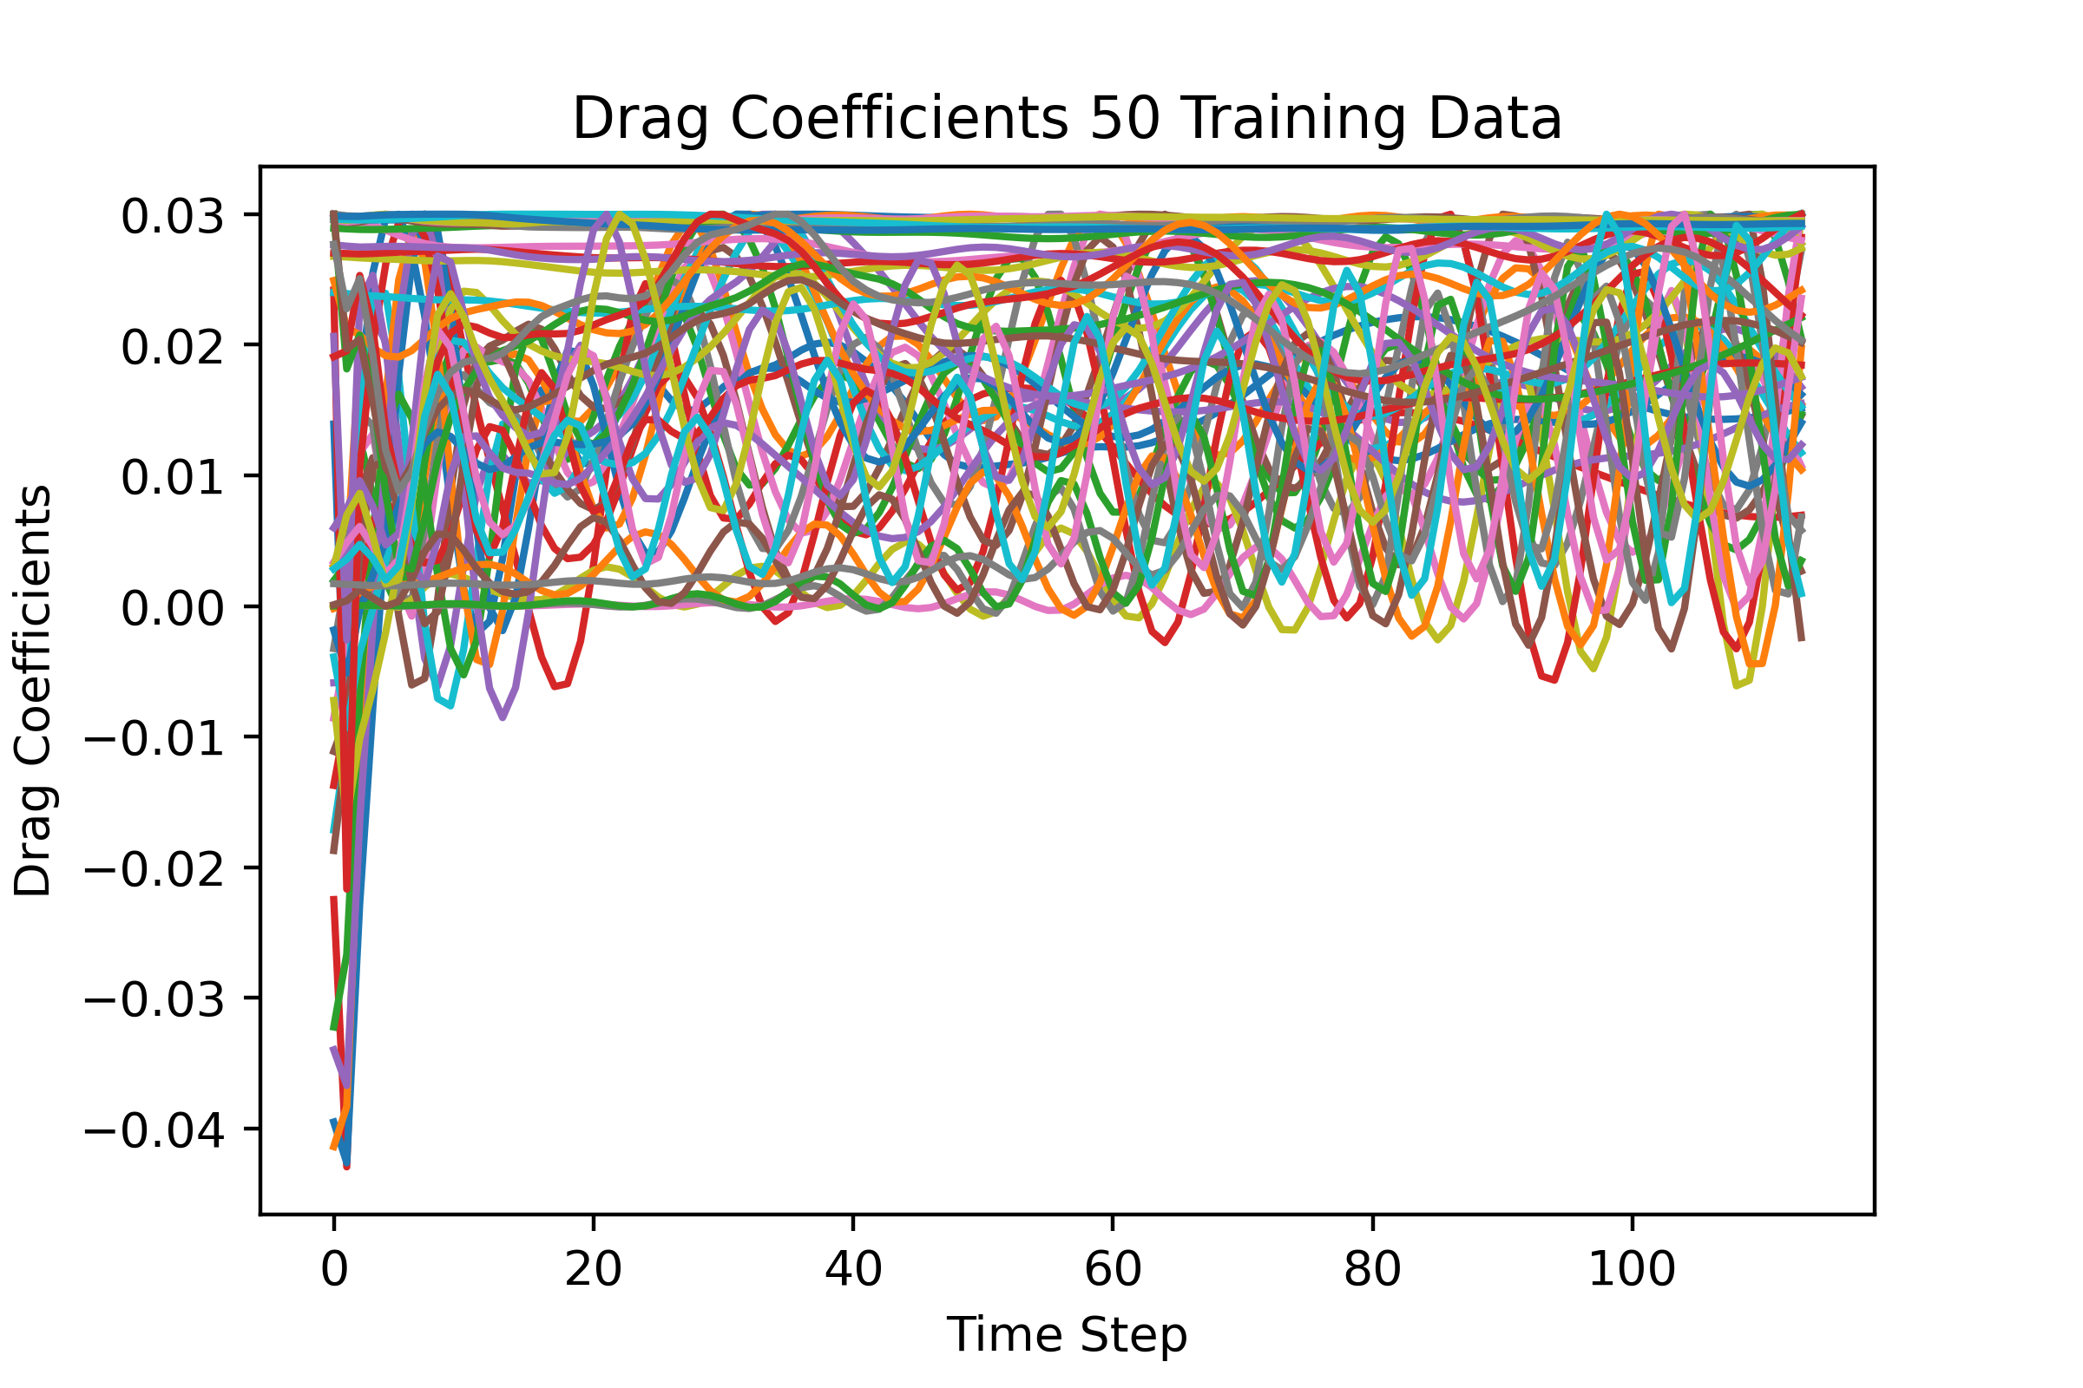
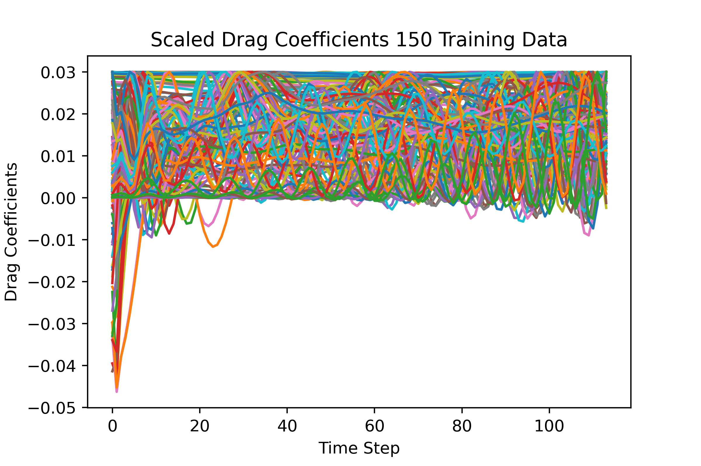
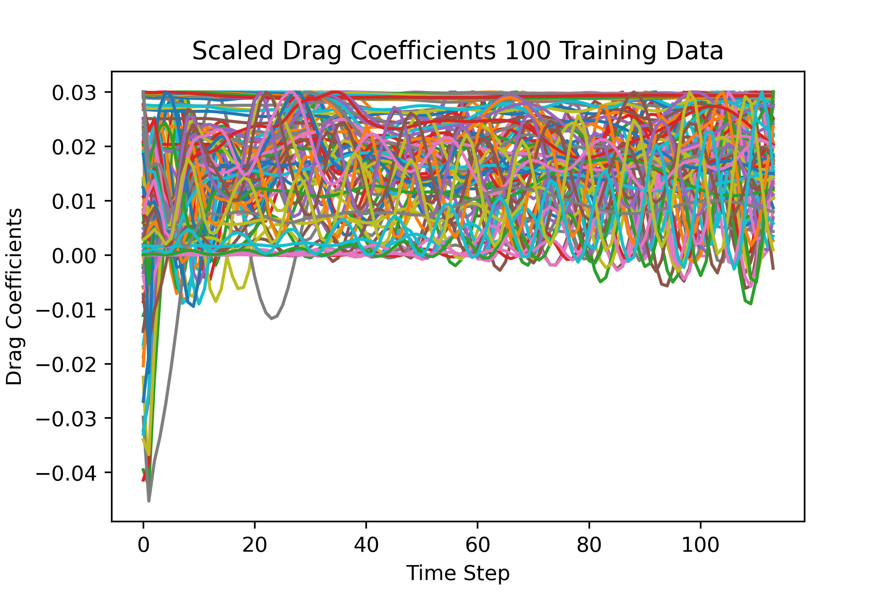
Appendix: CD Training Dataset

Slide 32
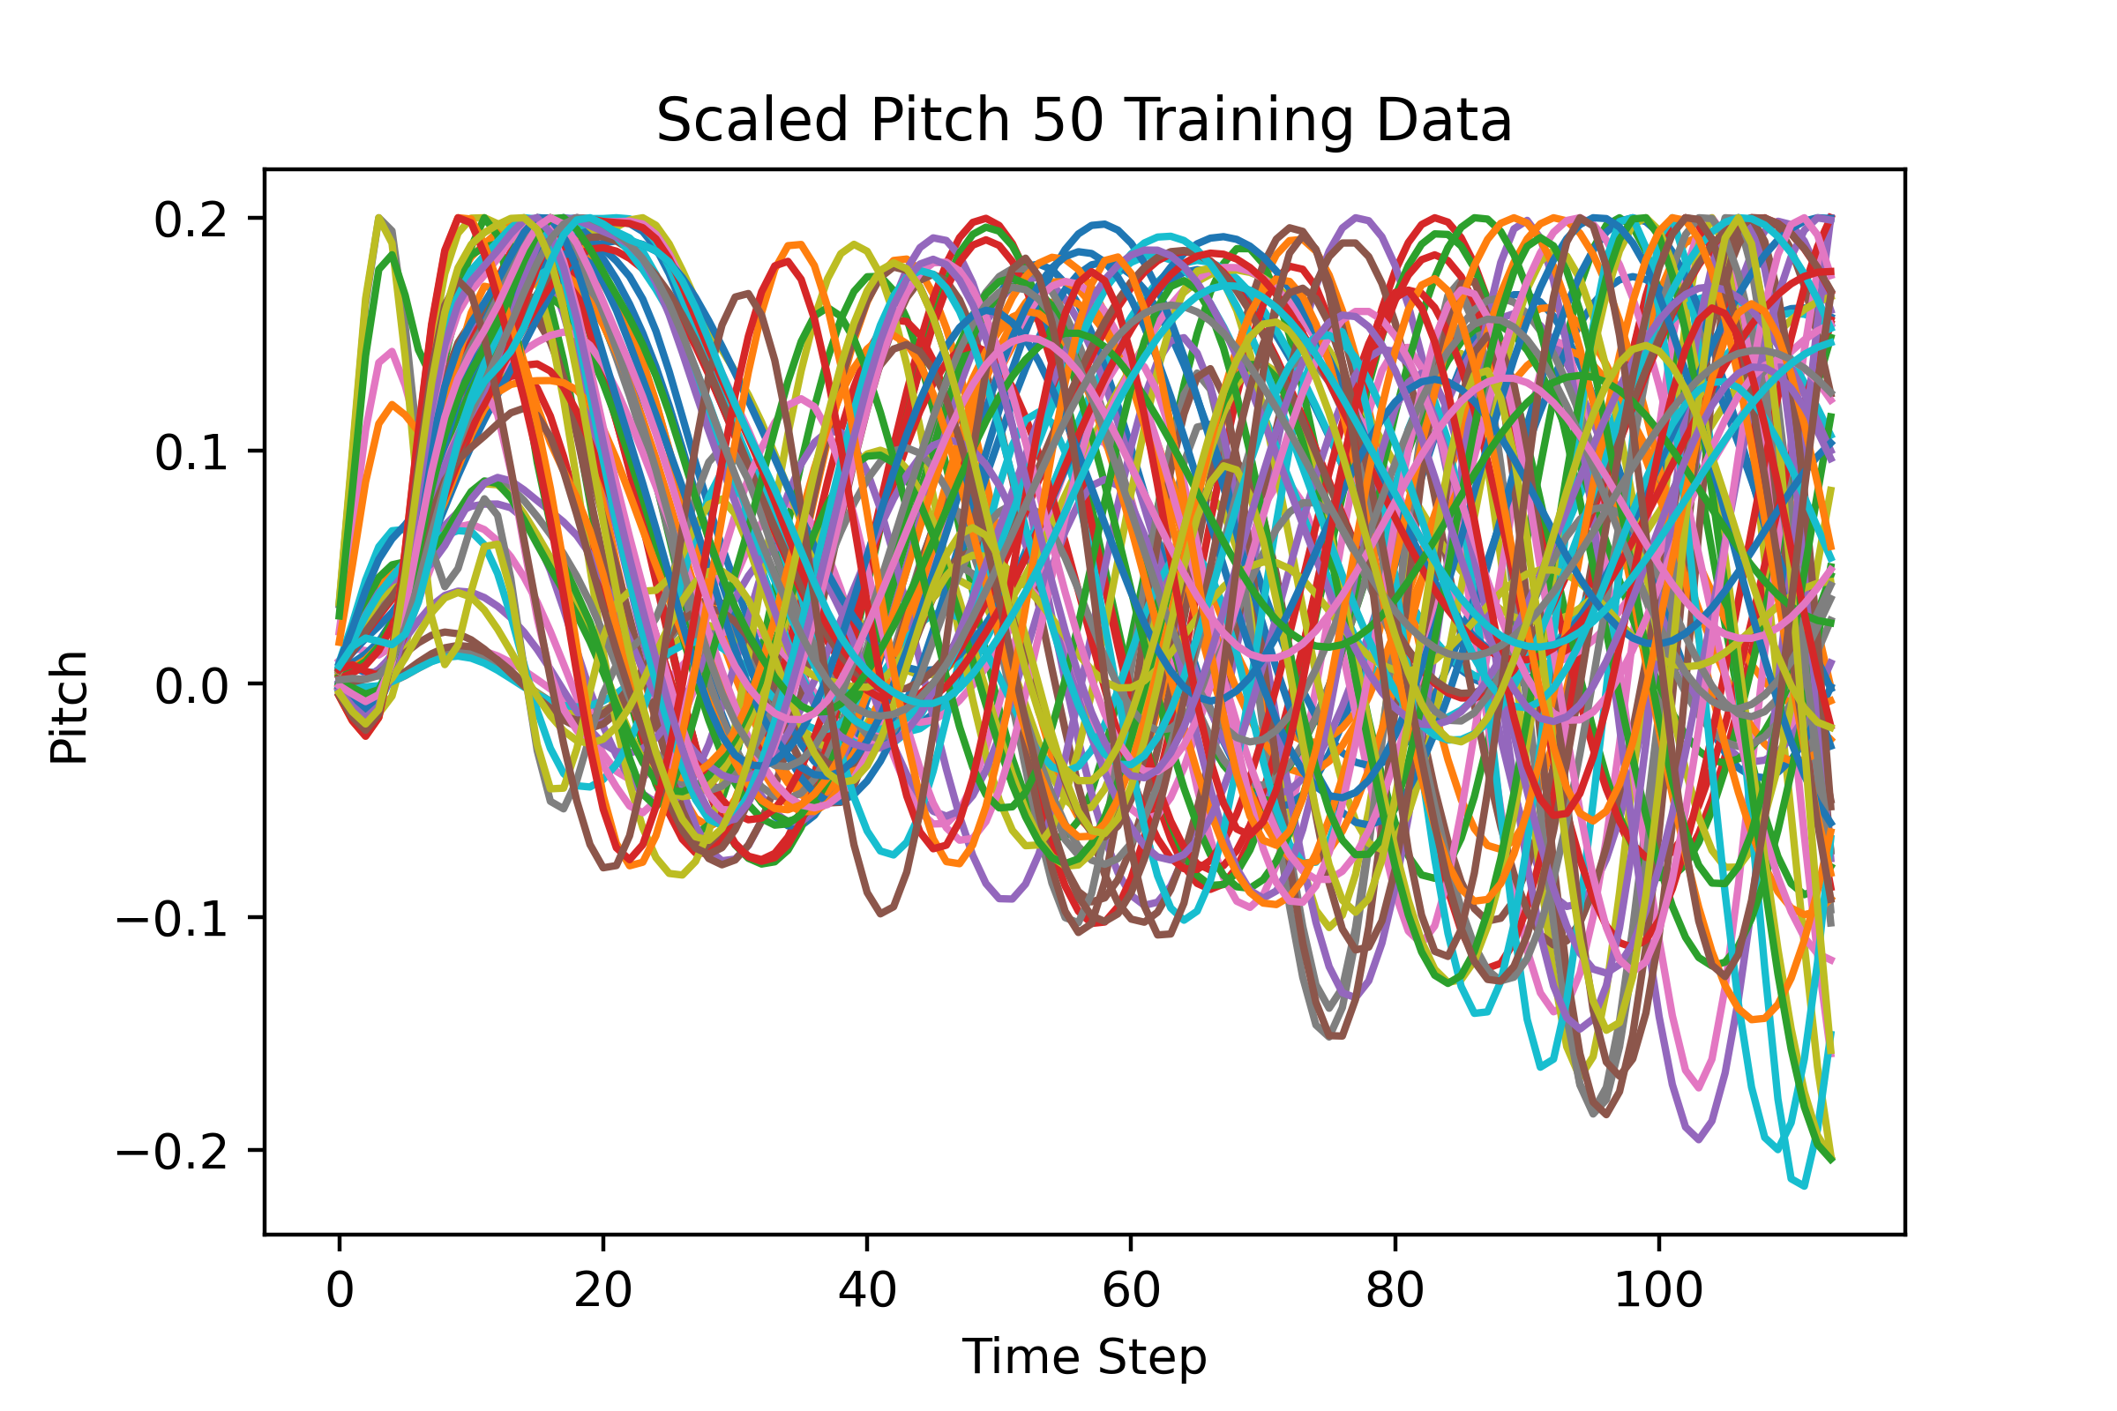
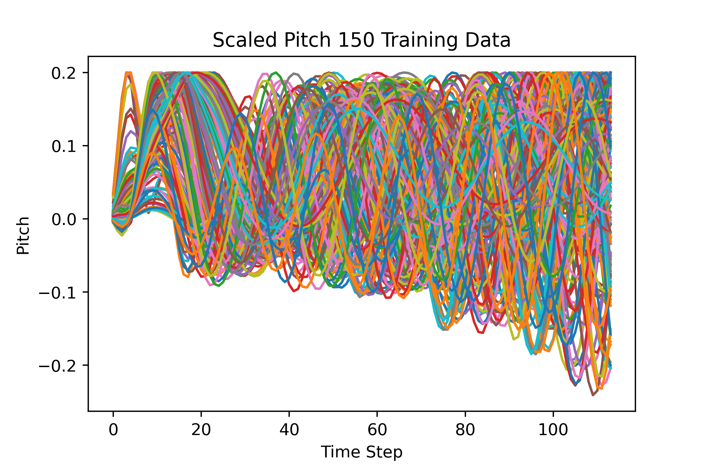
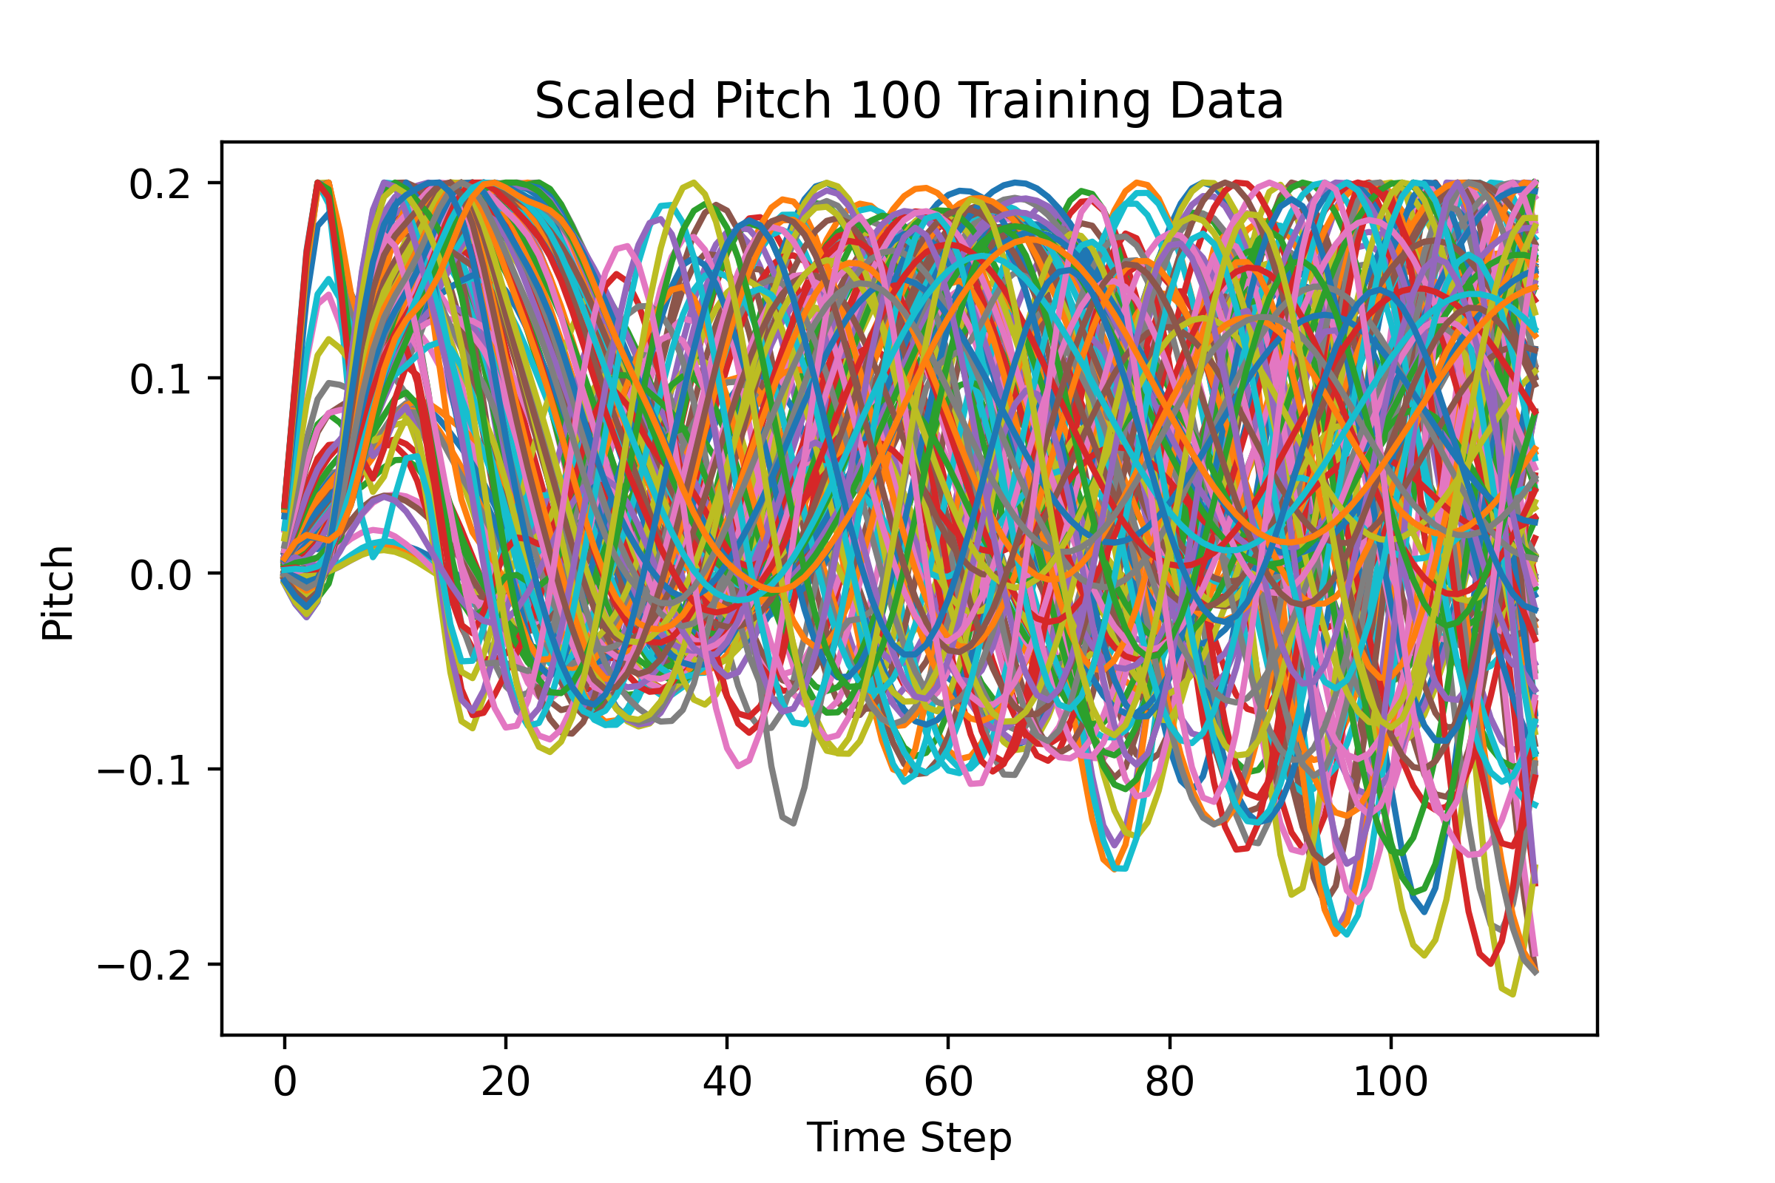
Appendix: Pitch Training Dataset

Slide 33
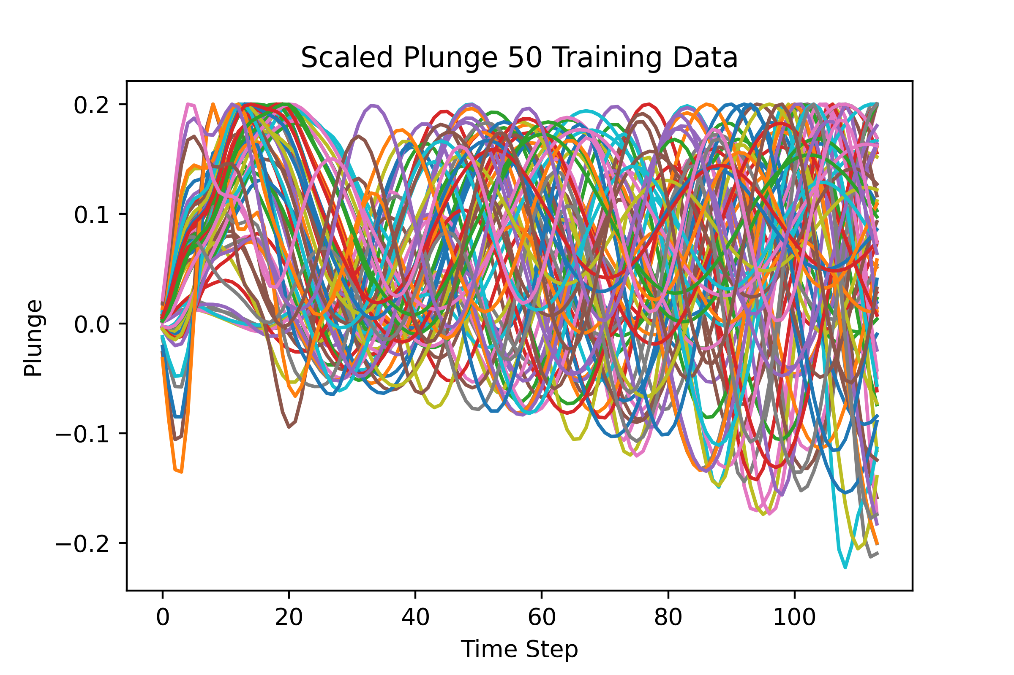
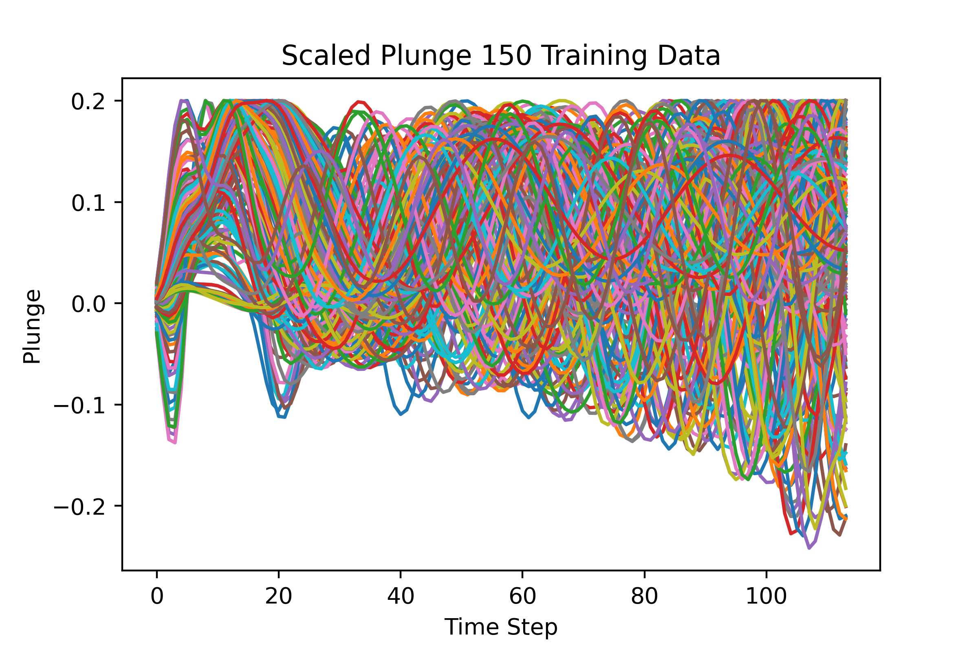
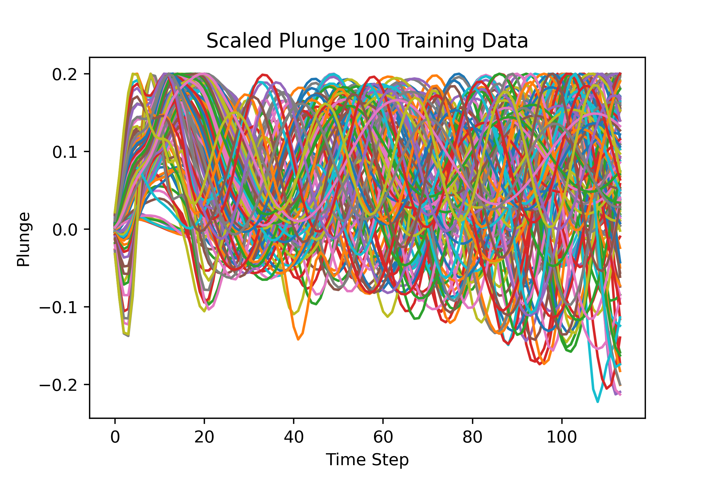
Appendix: Plunge Training Dataset

Slide 34
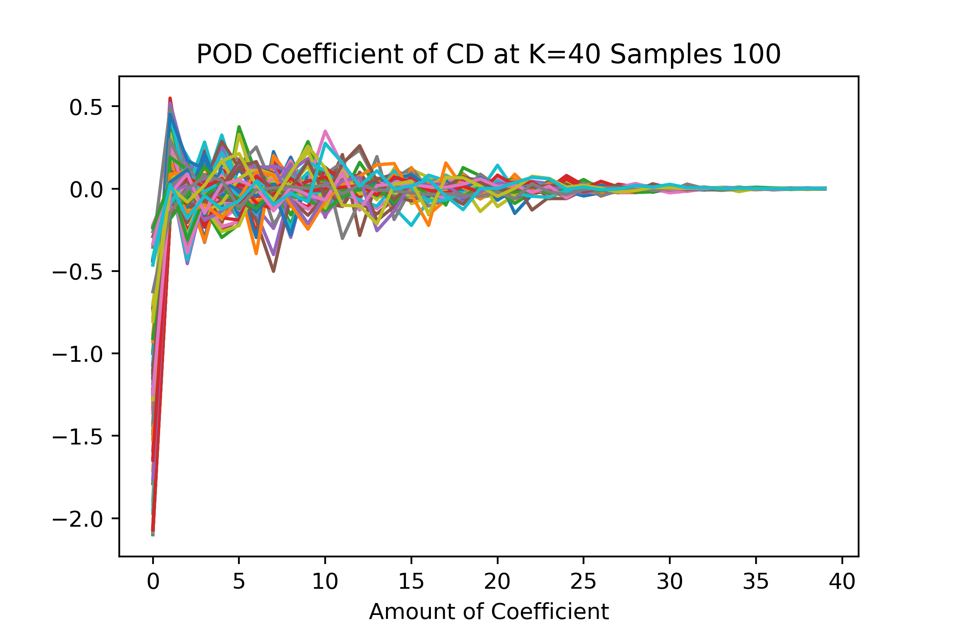


Appendix: POD Coefficients at K=40

Slide 35



Appendix: POD Coefficients at K=40

Slide 36



Appendix: POD Coefficients at K=40

Slide 37



Appendix: POD Coefficients at K=40

Slide 38
Appendix: Multiplier

Slide 39

Appendix: Multiplier

Slide 40


Appendix: POD Loss

Slide 41


Appendix: POD Loss

Slide 42

Appendix: Damping Coefficients Flutter Boundary

Slide 43



Appendix: Damping Coefficients Surface

Slide 44



Appendix: Another Test

Slide 45



Appendix: Another Test

Slide 46



Appendix: Another Test

Slide 47



Appendix: Another Test

Slide 48



Appendix: Another Test

Slide 49


Appendix: Without POD
CD
CL

Slide 50


Appendix: Without POD
Plunge
Pitch

Slide 51
Introduction
Theory
Methodology
Result
Conclusion
Aeroelastic Analysis is very crucial to design modern aircraft and The cost of Aeroelastic Experimentation and Simulation is Very Expensive -> Surrogate Model.
Background
The surrogate model needs to be trained with labeled data -> Supervise Machine Learning -> Deep Learning->Proper Orthogonal Decomposition
Simulation Point (M, Vf) | Computational Cost (CPU-s)
(0.7, 0.4) | 3248
(0.9, 0.4) | 4482
(0.88, 1.7) | 9198
(0.7, 2.0) | 9317
(0.7875, 2.0) | 9911
Fig1 : Flutter caused tailplane failure and crash of Grob SPn prototype
Tab1: Computational Cost of Aeroelastic Simulation (Faiz, 2020)
Fig2: Surrogate Model Comparison with Simulation
Notes:
The first figure here is the prototype airplane which crashed due to flutter at tailplane. This accident will throw a lot of resources and the cost will be very expensive, that’s why we want to prevent it by doing the aeroelastic simulation as I show u at second figure. The aeroelastic simulation itself is not cheap as to get the idea of its cost I show u the table 1 here. This table show us the cost of one simulation point at one condition and 1 section and its time cost is already 4-5 hours. To minimize this cost is the reason of this research.

